Slide 1
The mouse as a model for neuropsychiatric drug development
James Howe
ICLM Journal Club
March 1, 2019

Slide 2
”Mental health is experiencing a crisis in the development of new treatments”
-- Thomas Insel, then-Director of the NIMH
Insel et al., 2004, Neurosci Biobehav Rev.

Slide 3
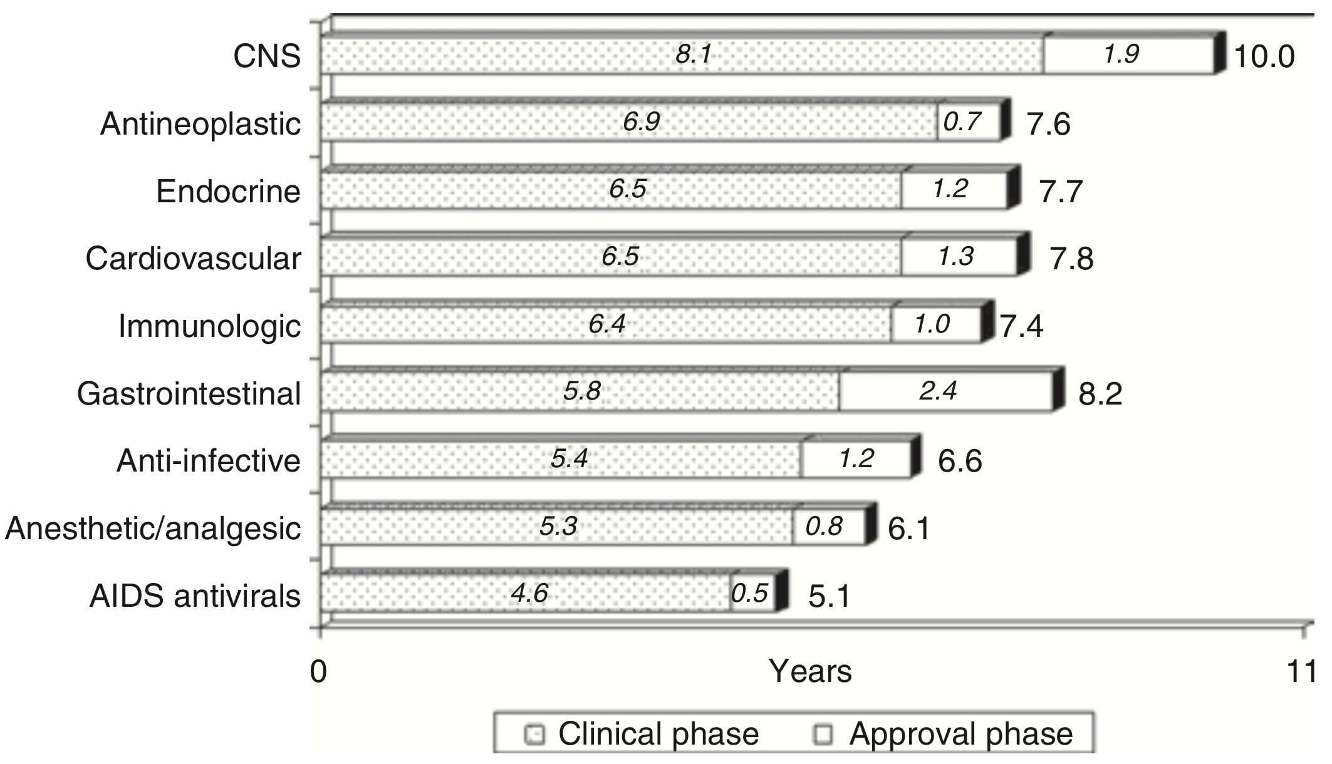
Kaitin and DiMasi, 2001,
Clin Pharmacol Ther

Slide 4
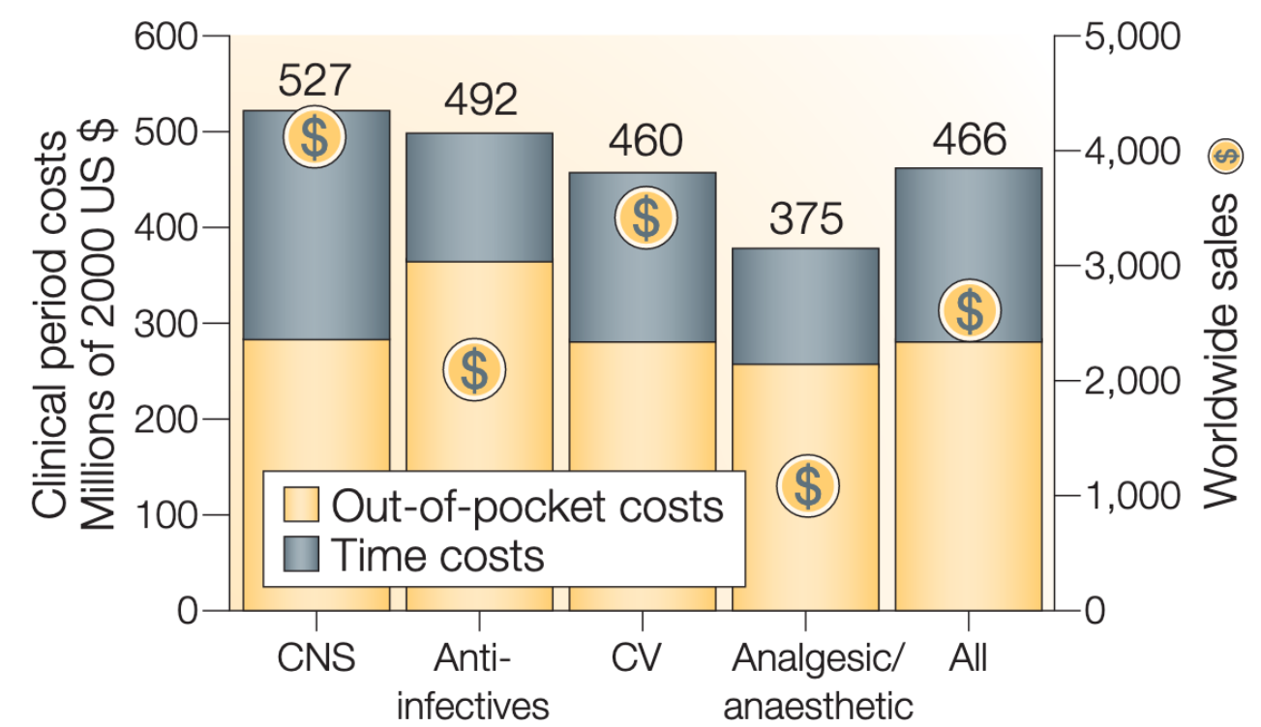
Frantz, 2004
Nat Rev Drug Discovery

Slide 5
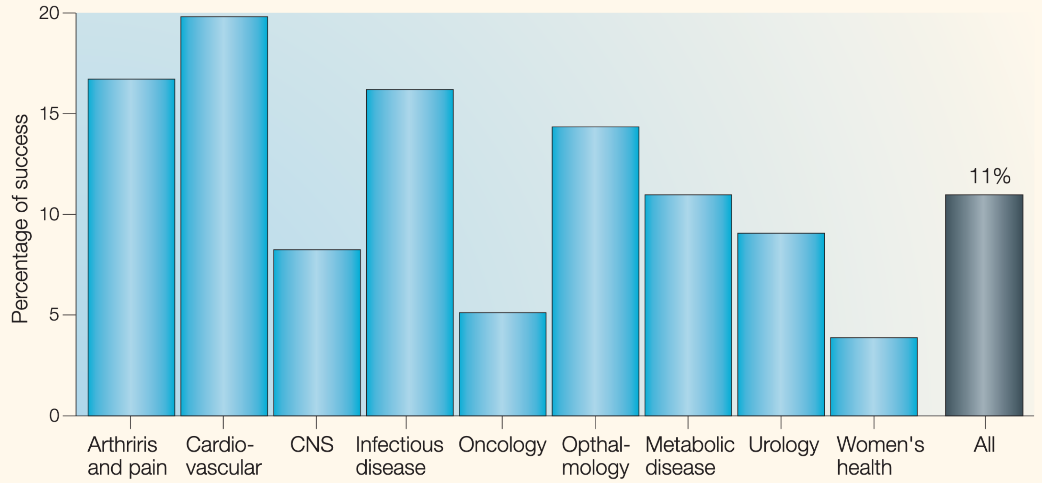
Kola and Landis, 2004
Nat Rev Drug Discovery

Slide 6
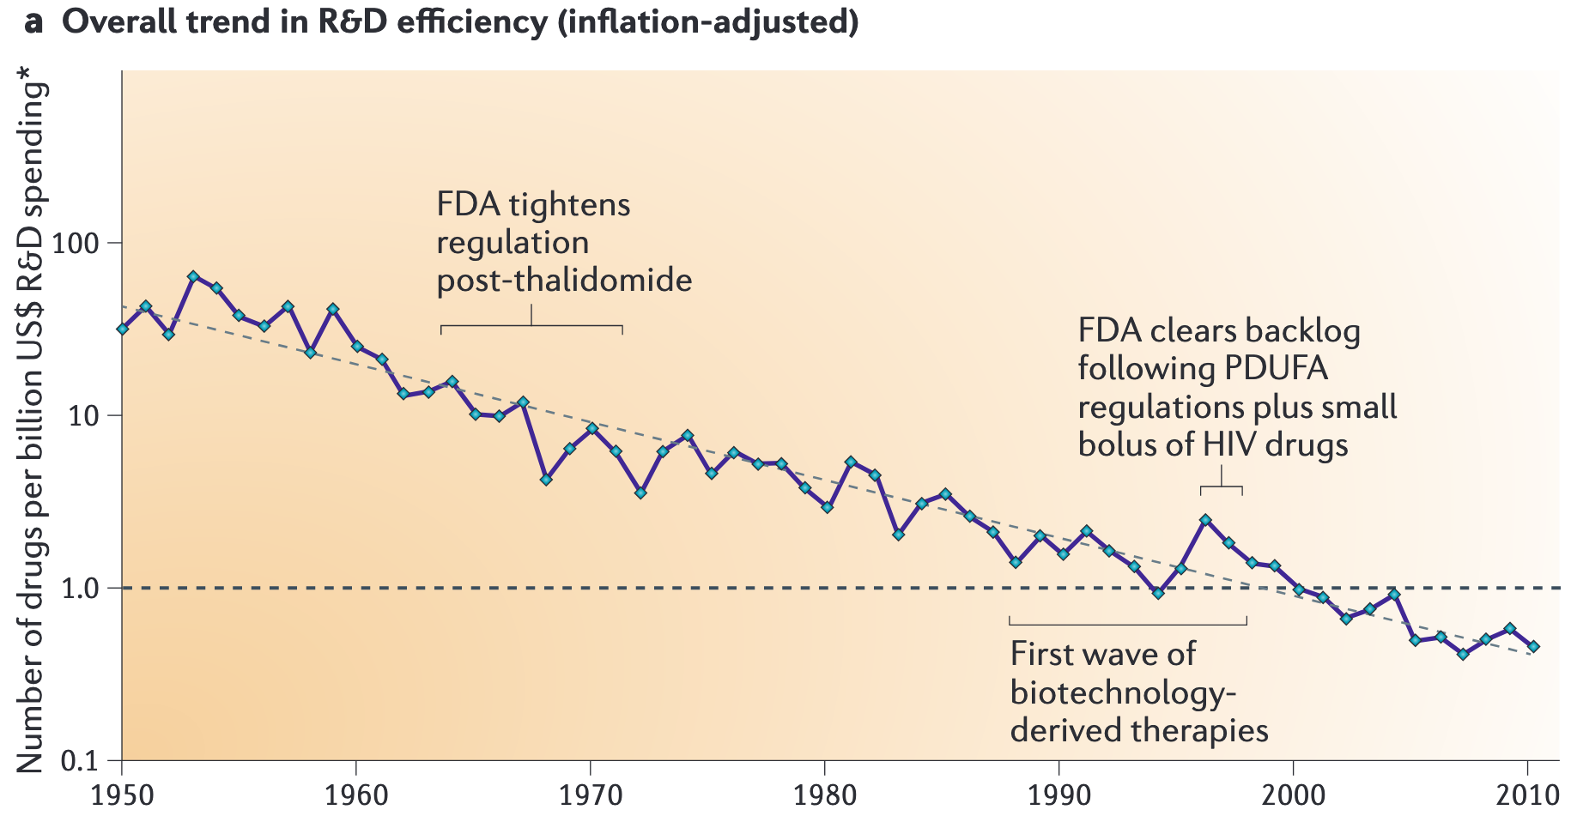
Scannell et al., 2012
Nat Rev Drug Discovery

Slide 7
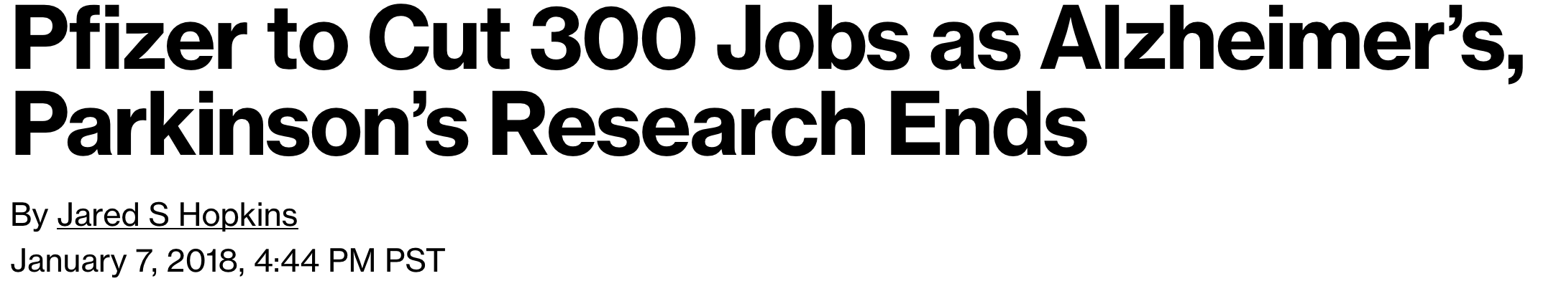



Slide 8
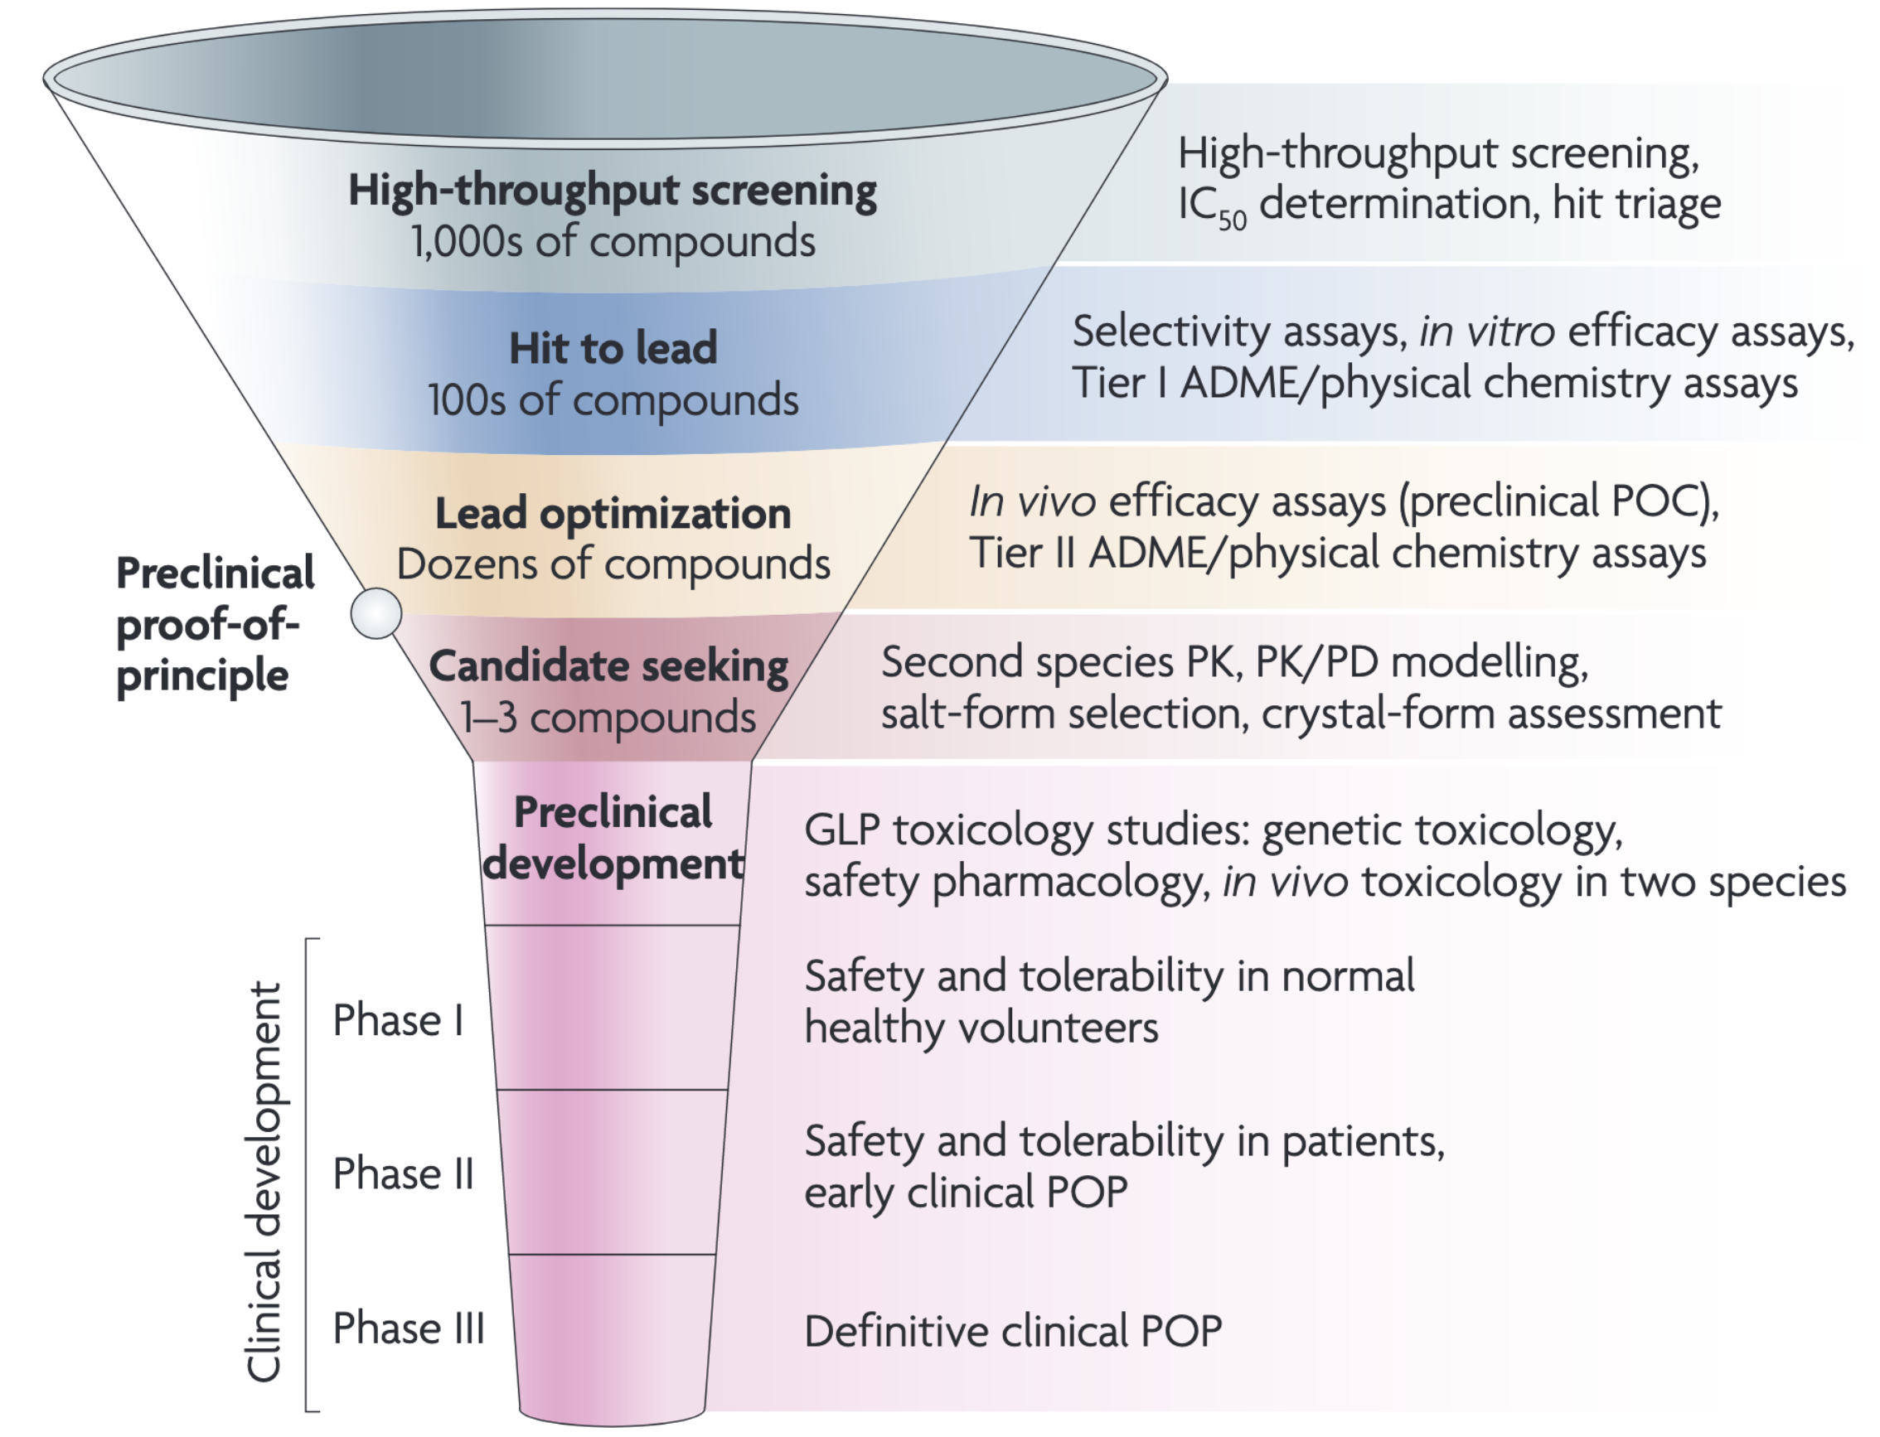
Kramer et al., 2007
Nat Rev. Drug Discovery

Slide 9
Kramer et al., 2007
Nat Rev. Drug Discovery

Slide 10
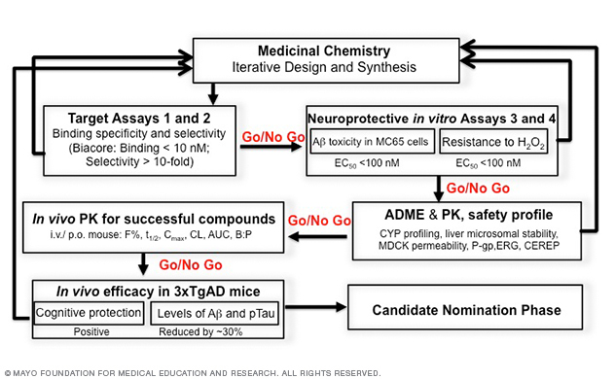
Trushina lab, Mayo Clinic

Slide 11
Why does drug development fail?
Overcautious regulation
“Better than the Beatles” problem
Diminishing returns to scale
Preclinical results non-predictive

Slide 12
Error in preclinical drug development
Improper standards of evidence
Poor statistics
Conflation of confirmatory and exploratory designs
Poor reproducibility
Improper modeling
Poor methods
Inadequate pharmacokinetic modeling
Species differences between mouse and man

Slide 13
Error in preclinical drug development
Improper standards of evidence
Poor statistics
Conflation of confirmatory and exploratory designs
Poor reproducibility
Improper modeling
Poor methods
Inadequate pharmacokinetic modeling
Species differences between mouse and man

Slide 14
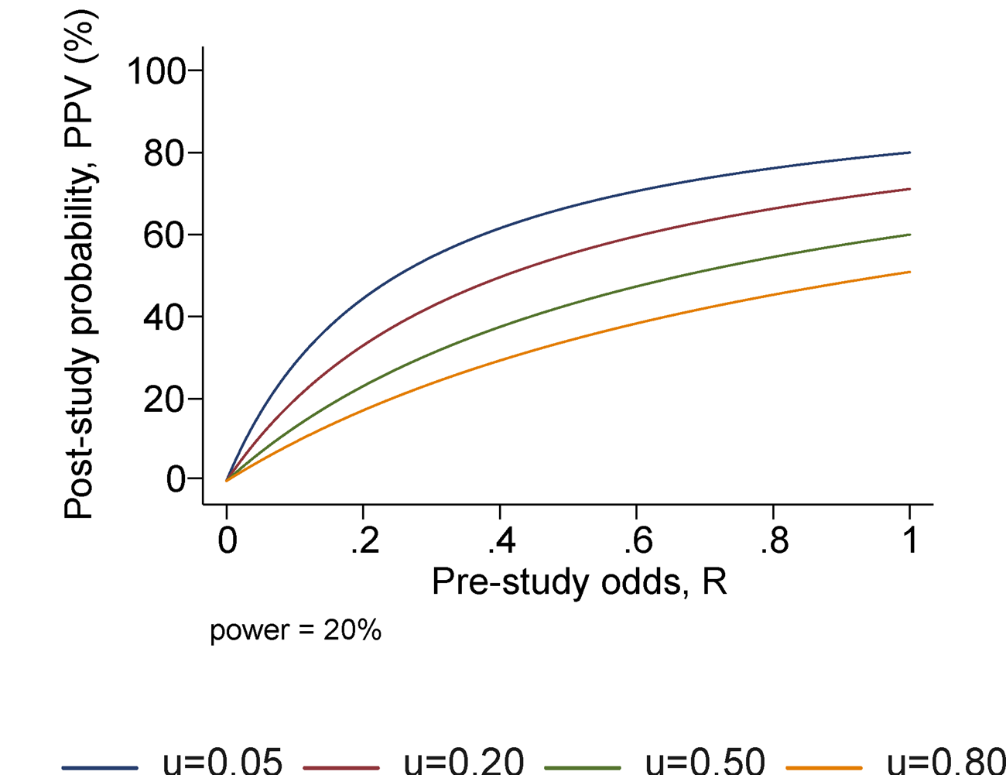
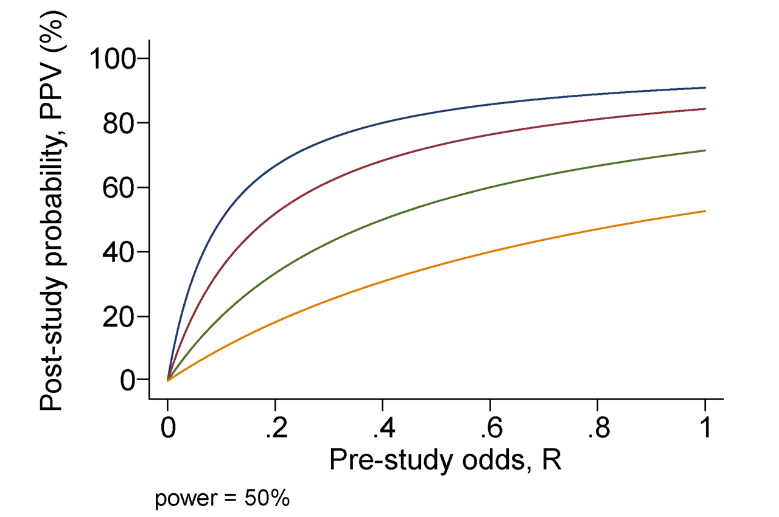
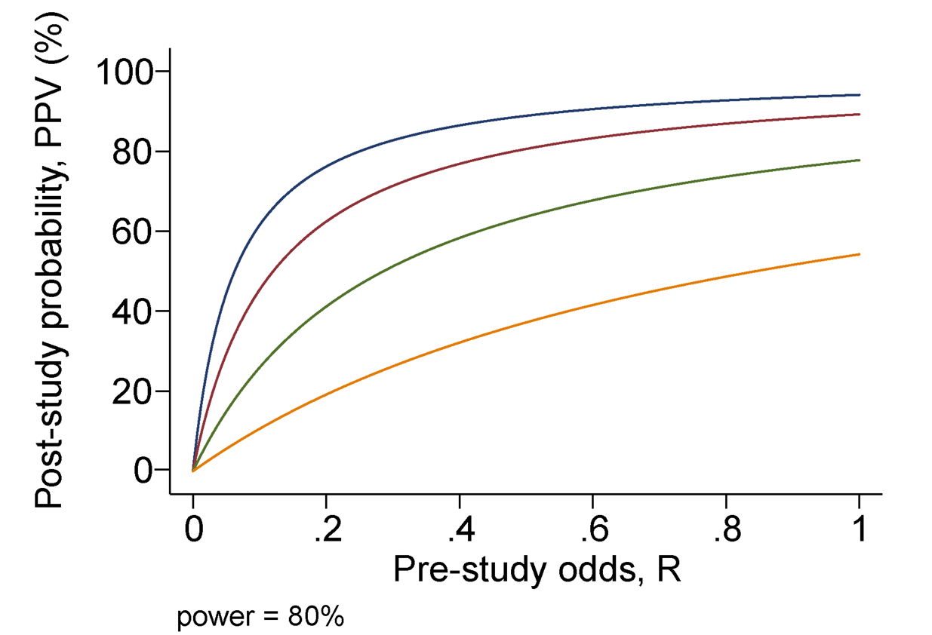
Ioannidis, 2005
PLOS Medicine

Slide 15
Error in preclinical drug development
Improper Standards of evidence
Poor statistics
Conflation of confirmatory and exploratory designs
Poor reproducibility
Improper modeling
Poor methods
Inadequate pharmacokinetic modeling
Species differences between mouse and man

Slide 16
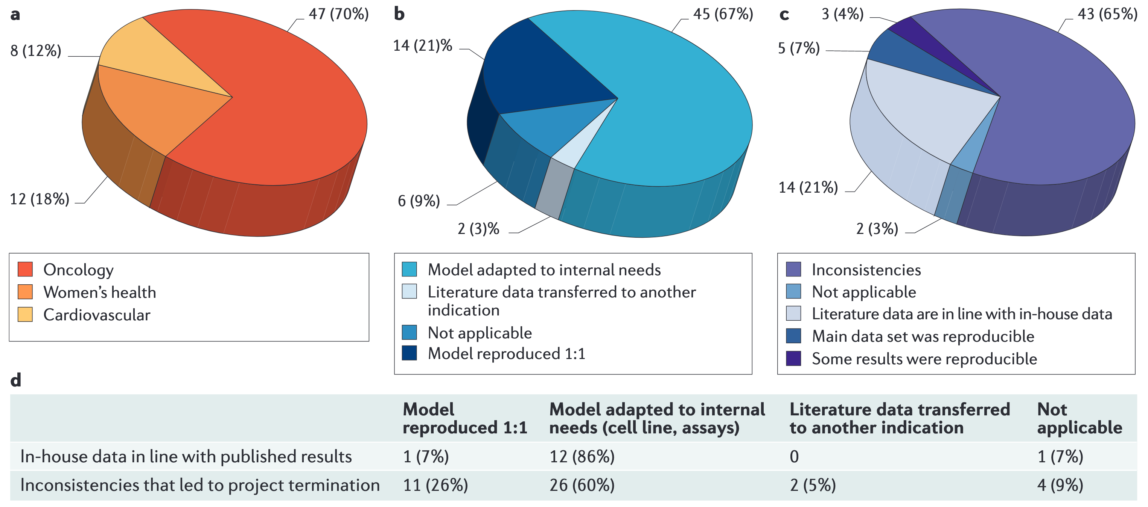
Prinz et al., 2011
Nat Rev Drug Discovery

Slide 17
Error in preclinical drug development
Improper Standards of evidence
Poor statistics
Conflation of confirmatory and exploratory designs
Poor reproducibility
Improper modeling
Poor methods
Inadequate pharmacokinetic modeling
Species differences between mouse and man

Slide 18
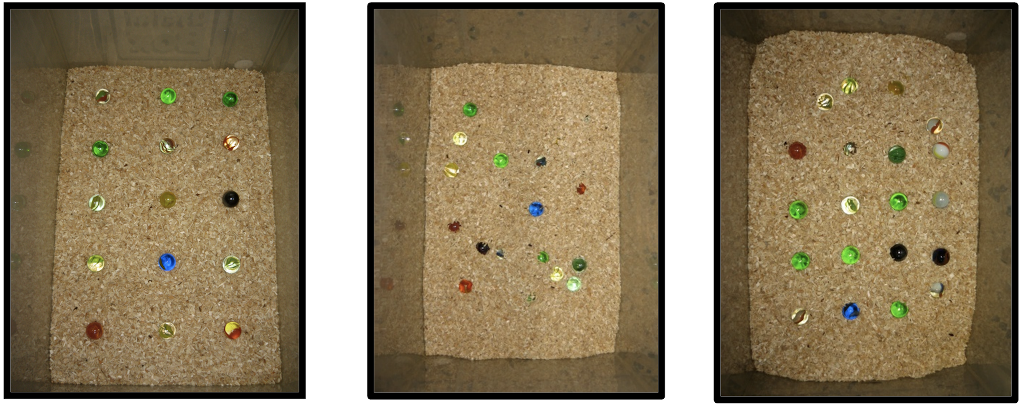
Gallo et al., 2014
PLOS ONE

Slide 19
Error in preclinical drug development
Improper Standards of evidence
Poor statistics
Conflation of confirmatory and exploratory designs
Poor reproducibility
Improper modeling
Poor methods
Inadequate pharmacokinetic modeling
Species differences between mouse and man

Slide 20
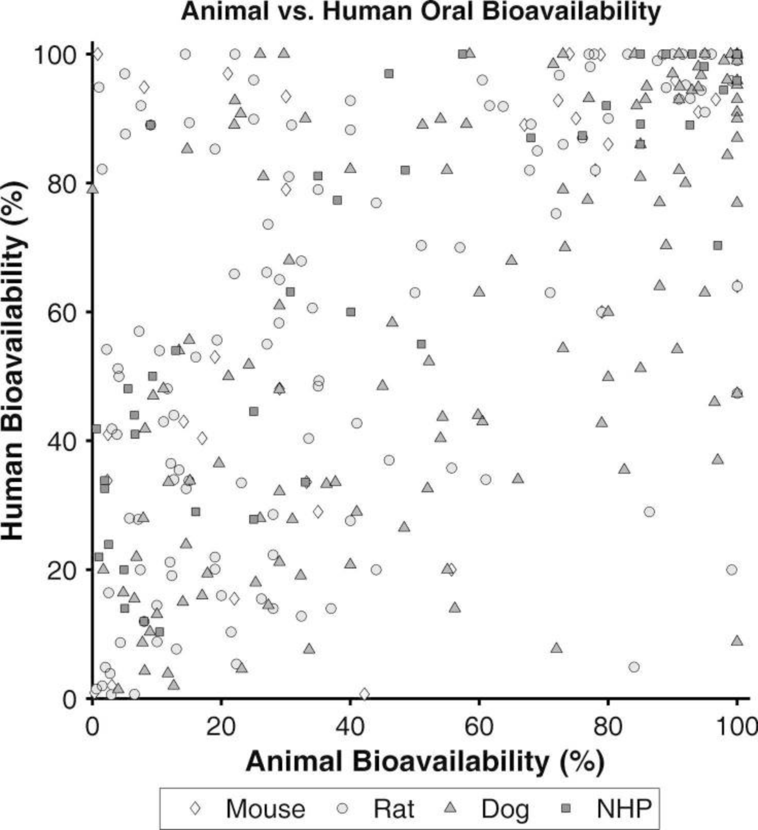
Musther et al., 2014
Eur J Pharm Sci

Slide 21
Error in preclinical drug development
Improper Standards of evidence
Poor statistics
Conflation of confirmatory and exploratory designs
Poor reproducibility
Improper modeling
Poor methods
Inadequate pharmacokinetic modeling
Species differences between mice and humans

Slide 22
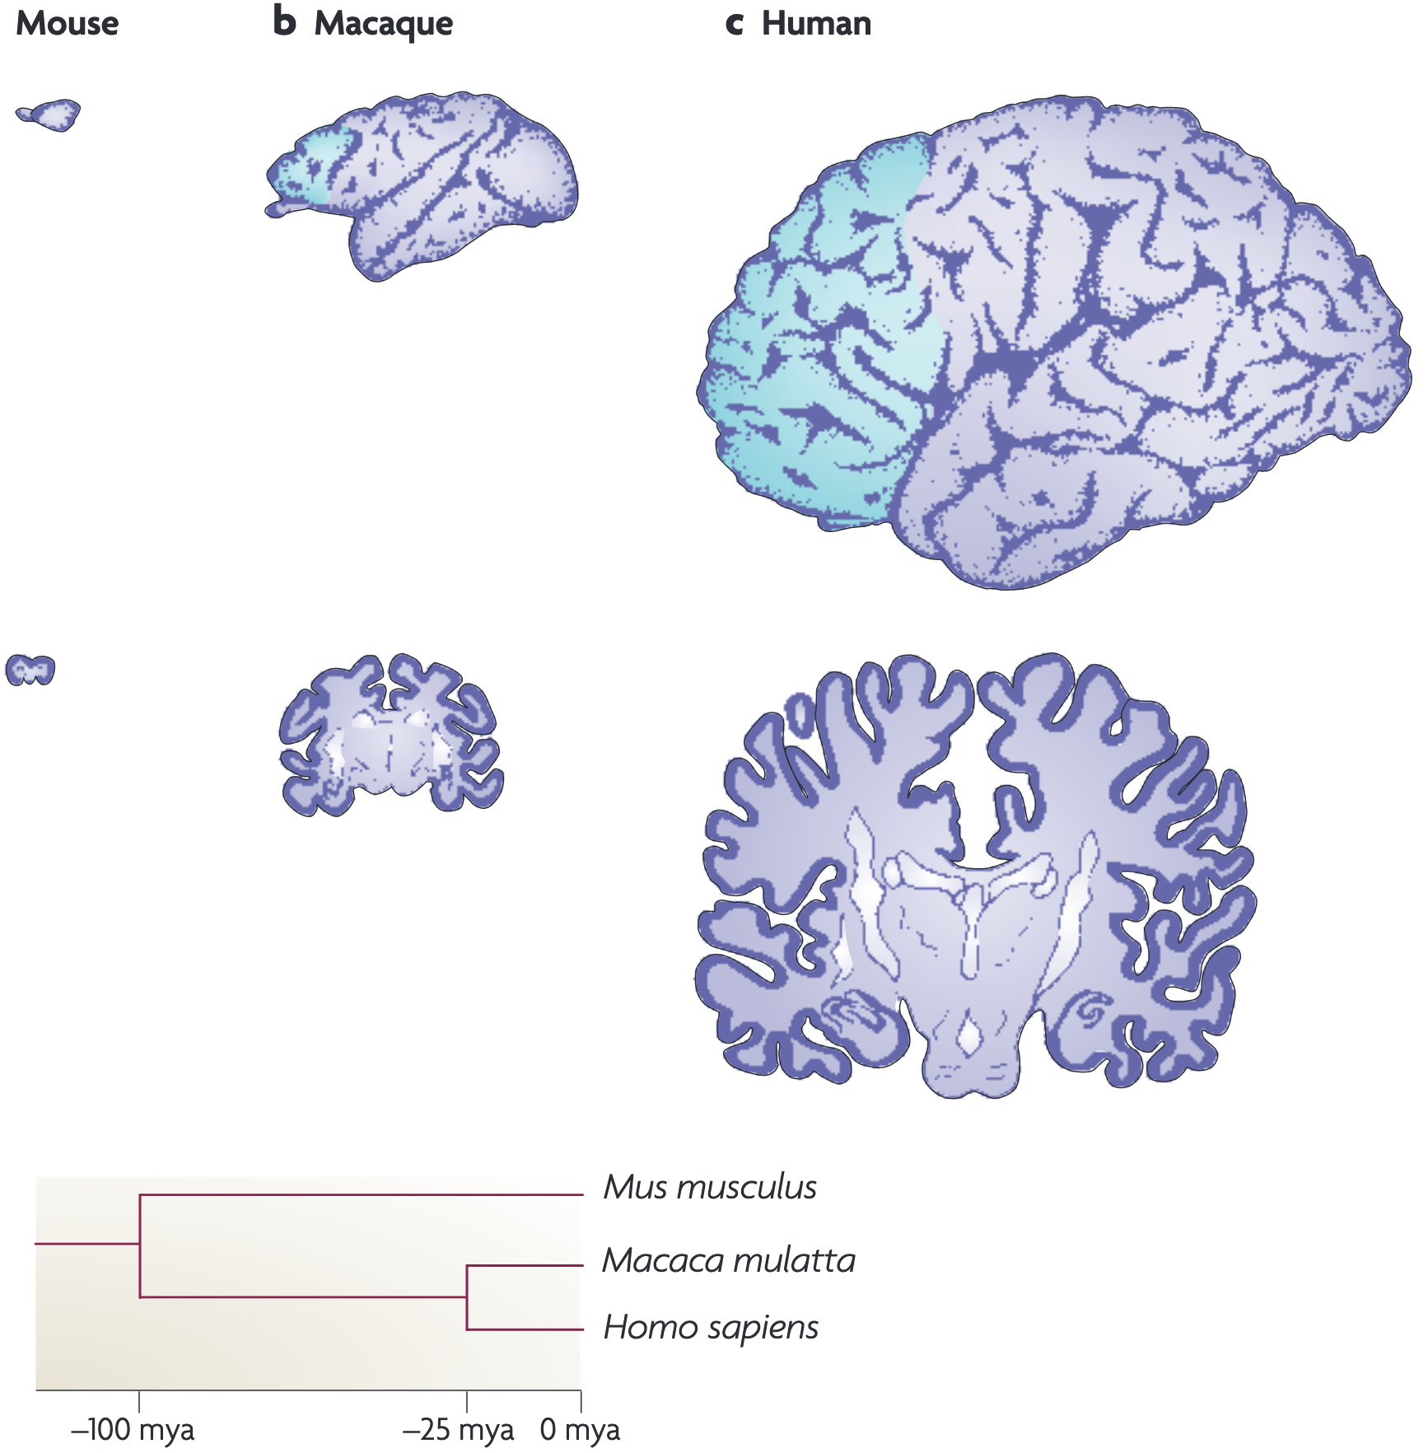
Rakic, 2009
Nat Rev Neurosci

Slide 23
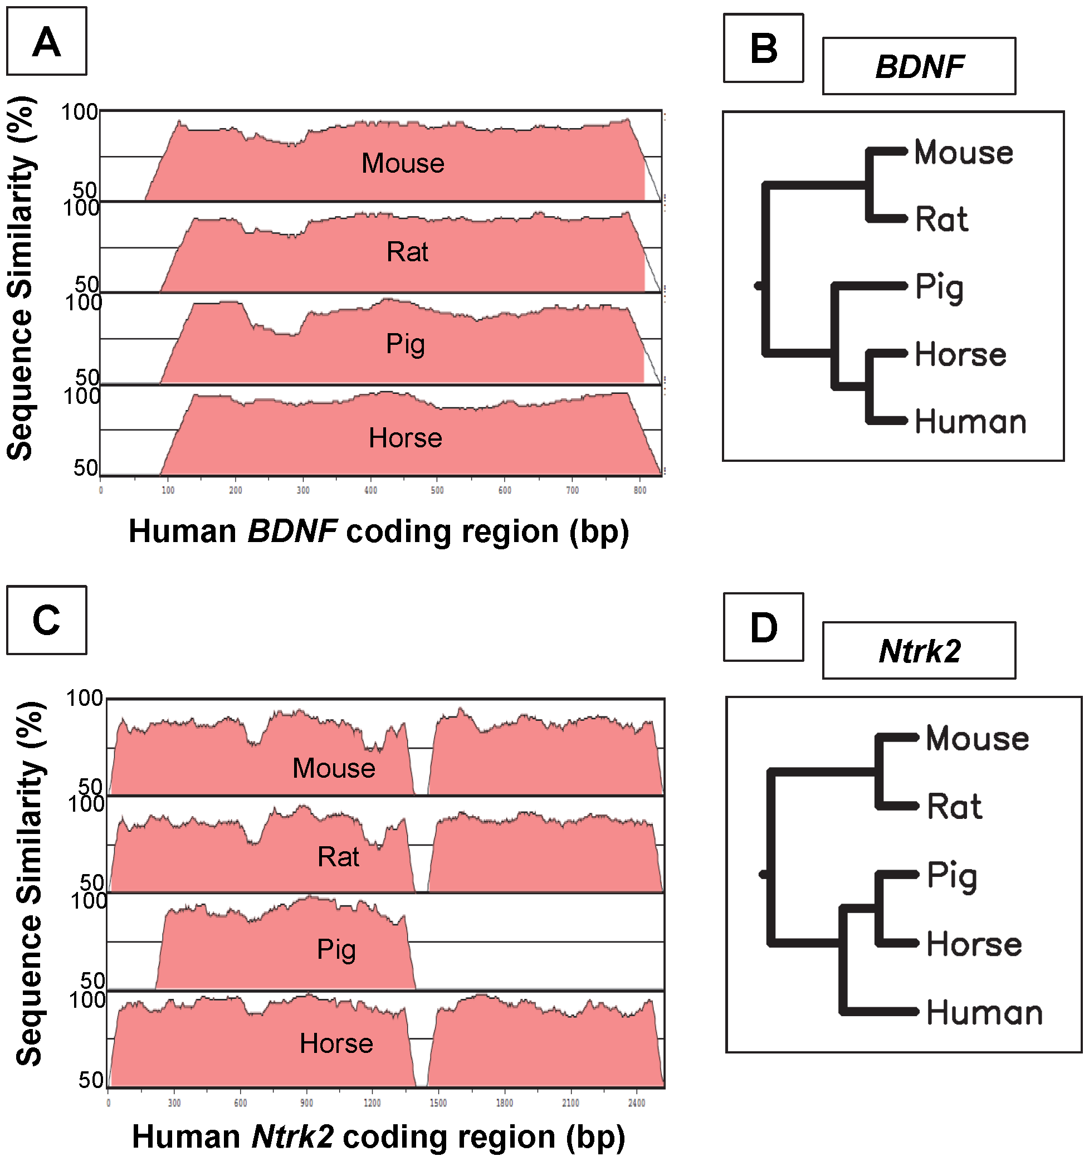
Wessels et al, 2014
PLOS ONE

Slide 24
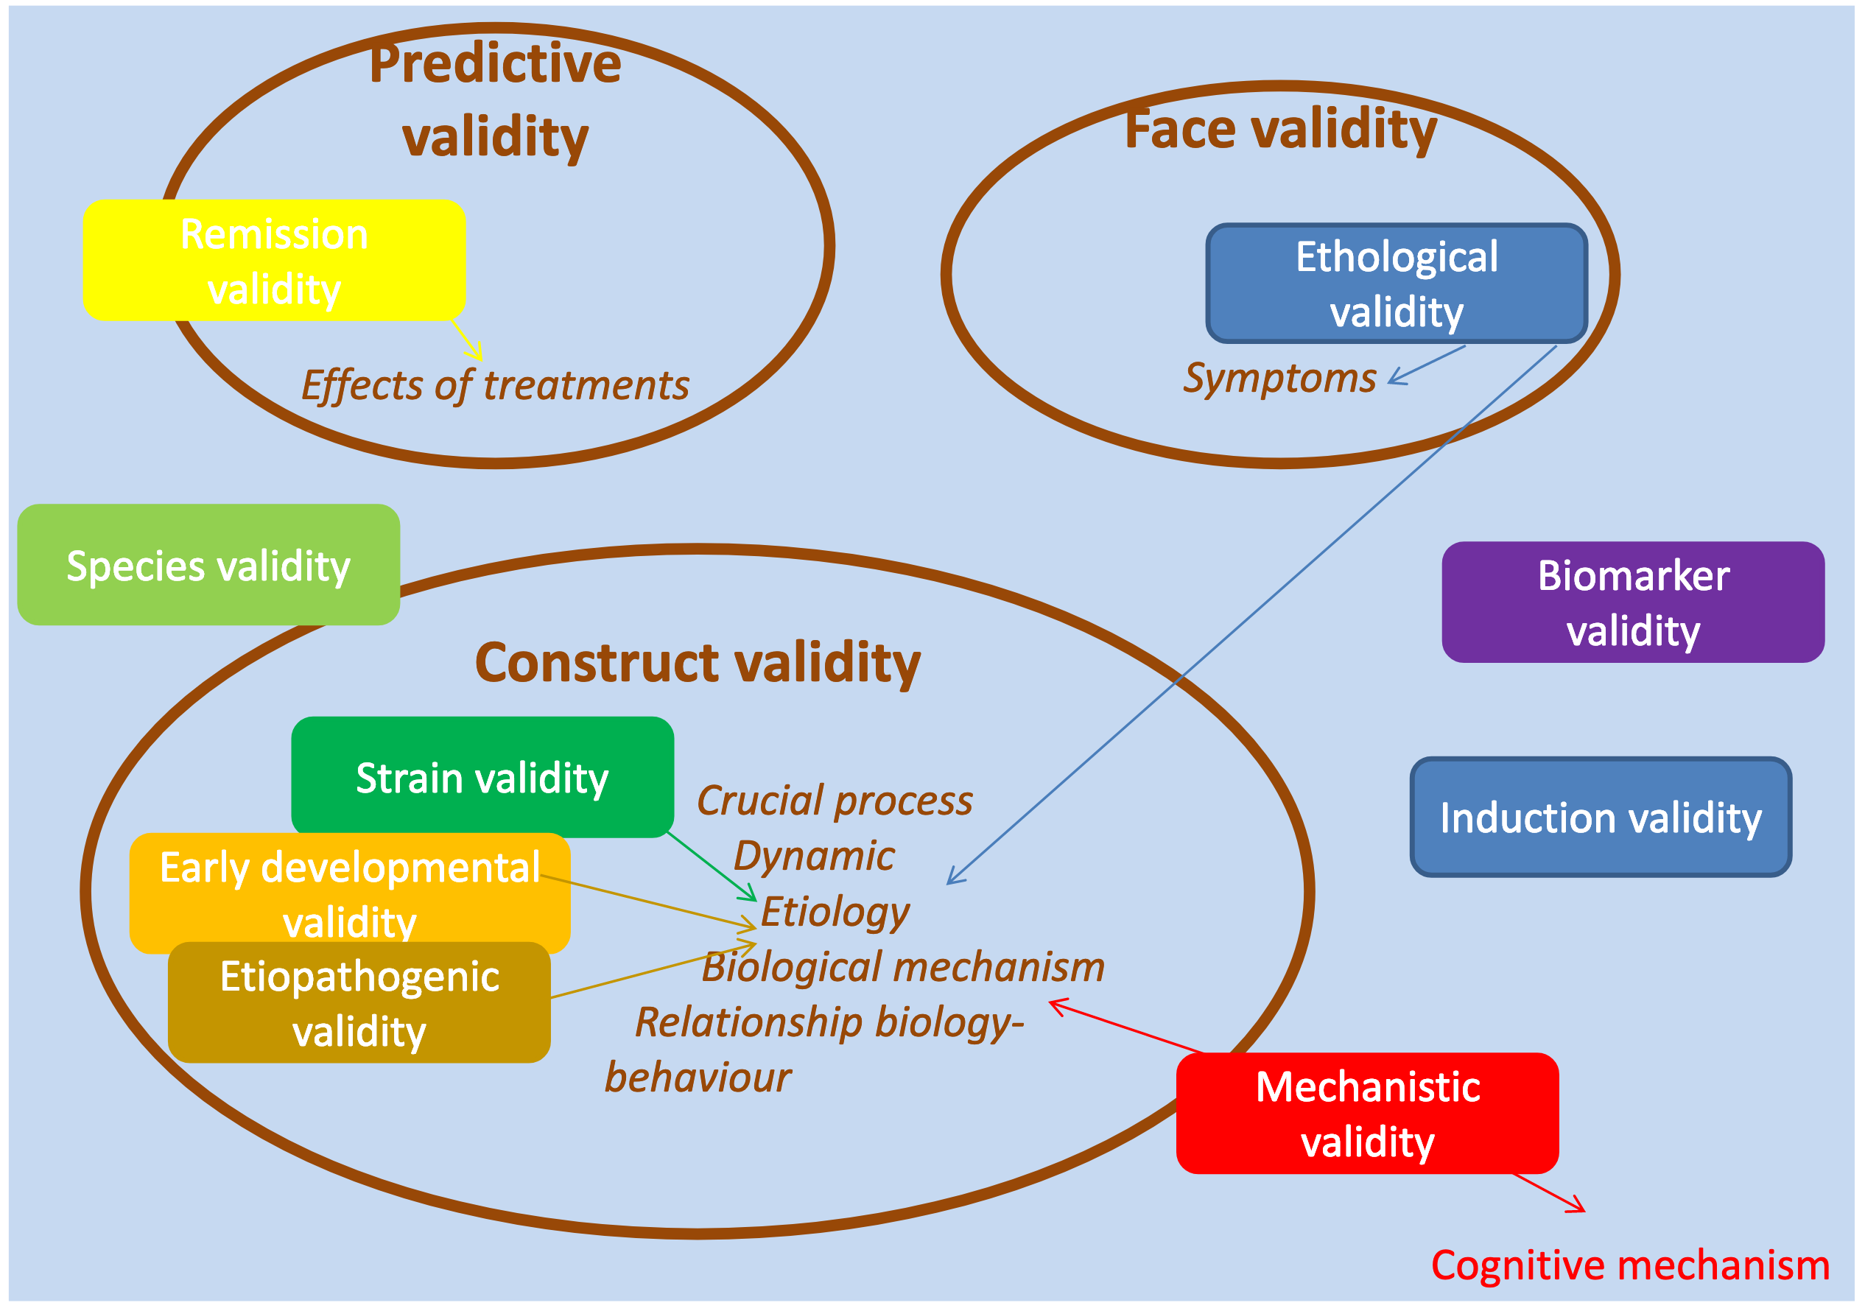
Belzung and Lemoine, 2011
Biol Mood Anxiety Disord

Slide 25
Howe et al., 2018
Current Biology

Slide 26
Are mice responsible for recent failures in neuropsychiatric drug development?

Slide 27
Design
Top 40 bestselling neuro drugs chosen
FDA approval for an indication defines human effectiveness
Only primary, active compounds included
Adjuncts judged on interaction with separate primary drugs
66 final drug-indication combinations

Slide 28
Drug | Indication | Drug | Indication
Sertraline | depression, anxiety, OCD | Oxycodone | pain
Citalopram | depression | Promethazine | pain, sedation
Fluoxetine | depression, anxiety, OCD | Pregabalin | pain
Escitalopram | depression, anxiety | Sumatriptan | pain
Trazodone | depression | Morphine | pain
Duloxetine | depression, anxiety, pain | Fentanyl | pain
Bupropion | depression, smoking cessation | Lamotrigine | seizures, bipolar disorder
Venlafaxine | depression, anxiety | Topiramate | seizures
Paroxetine | depression, anxiety, OCD | Levetiracetam | seizures (adjunct)
Amitriptyline | depression | Quetiapine | bipolar disorder, schizophrenia
Quetiapine | depression | Risperidone | bipolar disorder, schizophrenia
Mirtazapine | depression | amphetamine | ADHD, narcolepsy
Aripiprazole | depression (adjunct), bipolar disorder, schizophrenia, Tourette’s disorder | clonidine | ADHD
Alprazolam | anxiety | zolpidem | sedation
Clonazepam | anxiety, seizures | temazepam | sedation
Lorazepam | anxiety, seizures | baclofen | spasms
Diazepam | anxiety, spasms | methocarbamol | spasms
Buspirone | anxiety | donepezil | Alzheimer’s disease
Gabapentin | pain, seizures (adjunct) | ropinirole | Parkinson’s disease
Tramadol | pain | lidocaine | anesthesia

Slide 29
What studies do we include?
Used 25 highest-impact studies for each drug-indication combination in mice, if possible
Standardized search terms “[drug] + [indication]”
961 sources used in final analysis

Slide 30
What is success?
All assays judged based on the drug and indication
All combinations need to replicate in set of at least 3 studies
Judgment criteria:
  High confidence: >90% experiments significant
  Moderate confidence: 66-90% experiments significant
  Low confidence: >66% experiments significant in small sample
  Ineffective: <66% experiments significant

Slide 31
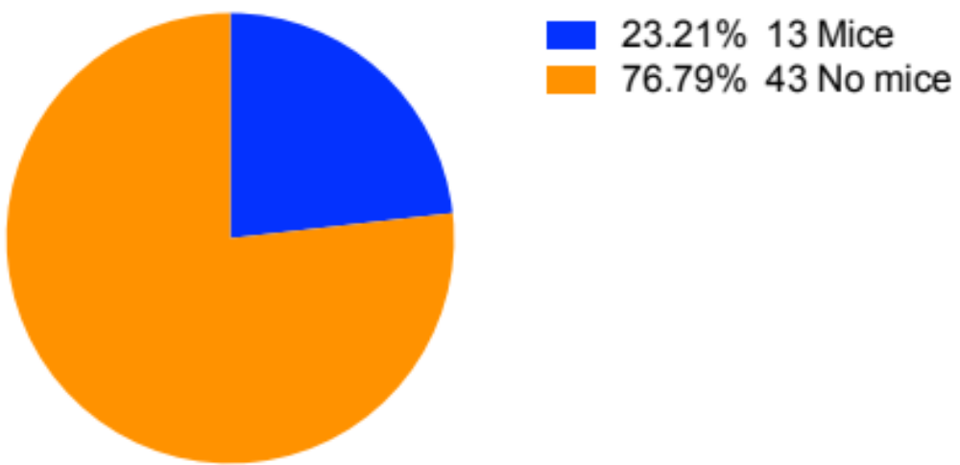
Mice in drug patents

Slide 32
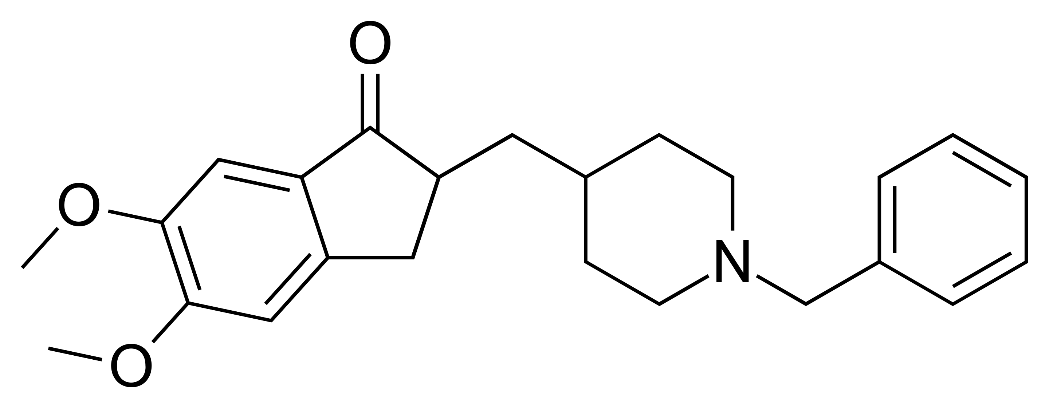
Donepezil

Slide 33
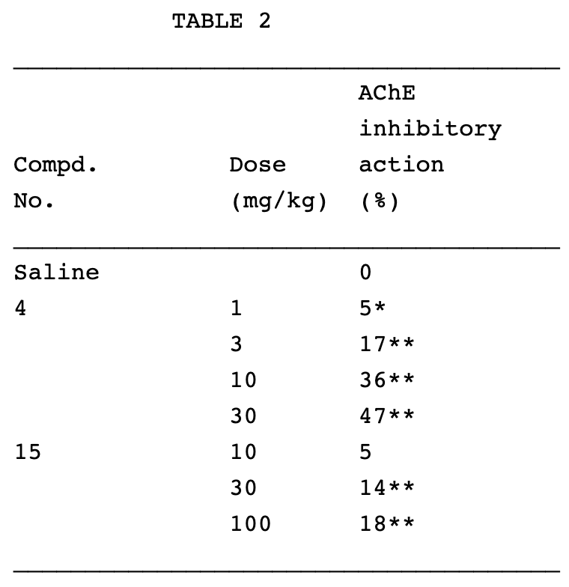
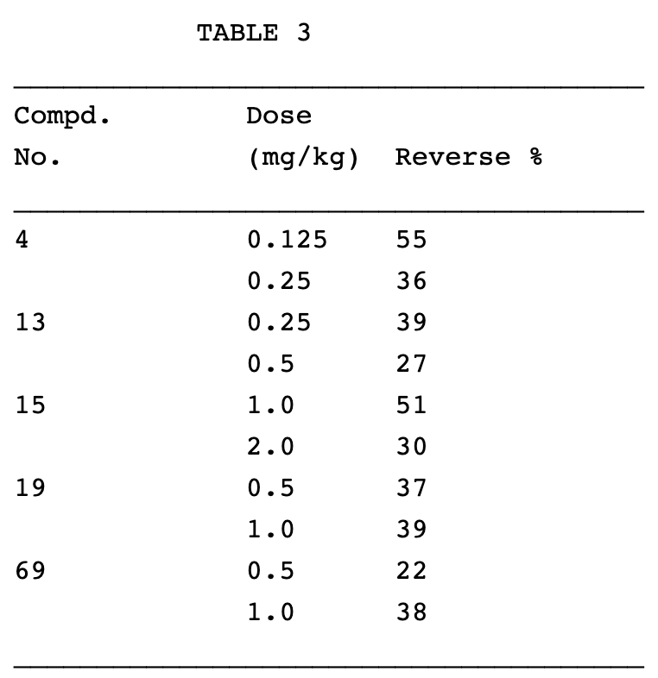
US Patent 4895841

Slide 34
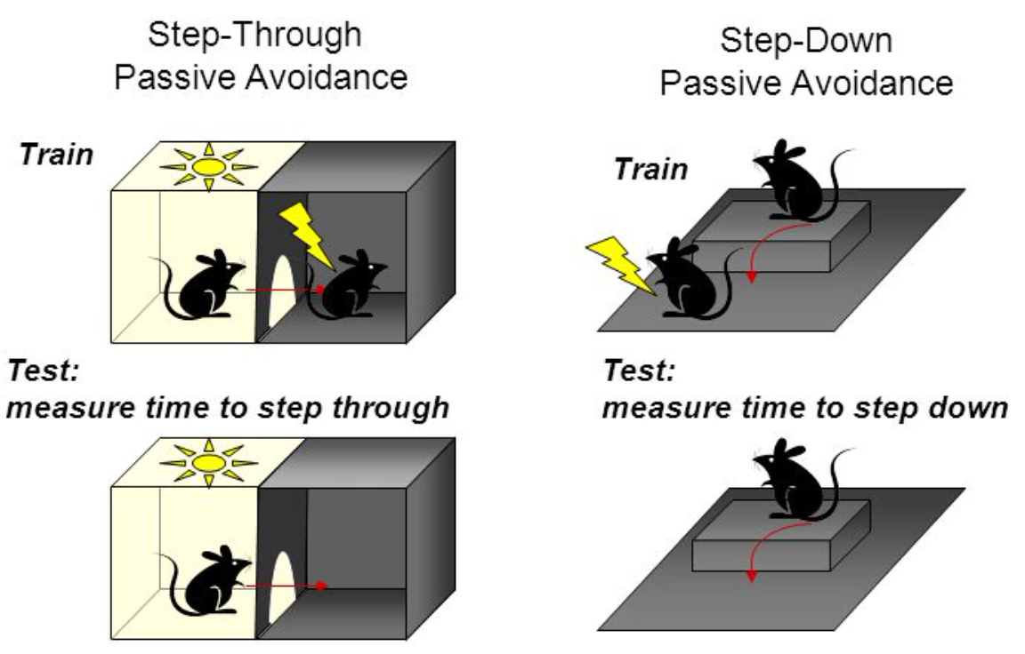
Sweatt, 2010
Mechanisms of Memory

Slide 35
US Patent 4895841

Slide 36
Authors | Journal | Year
Bontempi et al. | Neuropsychopharmacology | 2003
Cachard-Chastel et al. | Behavioral Brain Research | 2008
De Bruin et al. | Neurobiology of Learning and Memory | 2010
Dong et al. | Psychopharmacology | 2005
Furukaba-Hibi et al. | Behavioral Brain Research | 2011
Jeon et al. | Ethnopharmacology | 2011
Jeong et al. | European Journal of Pharmacology | 2008
Jung et al. | Phytomedicine | 2012
Kim et al. | Journal of Ethnopharmacology | 2013
Marighetto et al. | Psychopharmacology | 2008
Meunier et al. | British Journal of Pharmacology | 2006
Nagakura et al. | European Journal of Pharmacology | 2013
Prior et al. | Alzheimer’s Research and Therapy | 2012
Romberg et al. | Journal of Neuroscience | 2011
Saxena et al. | European Journal of Pharmacology | 2008
Sharma et al. | Journal of Psychopharmacology | 2008
Singh et al. | Journal of the Renin-Angiotensin-Aldosterone System | 2013
Spowart-Manning and van der Staay | Behavioral Brain Research | 2004
Tohda et al. | Brain Research | 2003
Van Dam et al. | Psychopharmacology | 2005
Yamada et al. | Journal of Ethnopharmacology | 2011
Zhang et al. | Journal of Alzheimer’s Disease | 2012

Slide 37

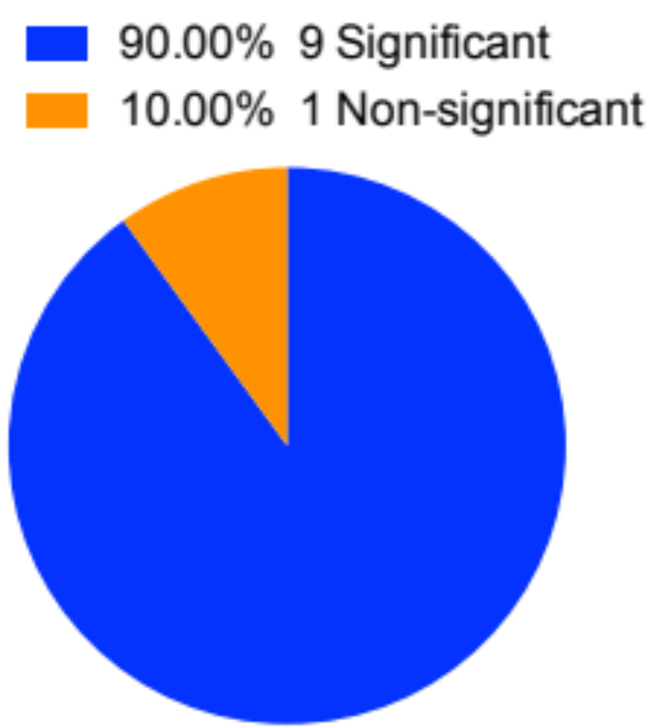
High confidence results in donepezil
Passive avoidance
Y/T maze alternation

Slide 38
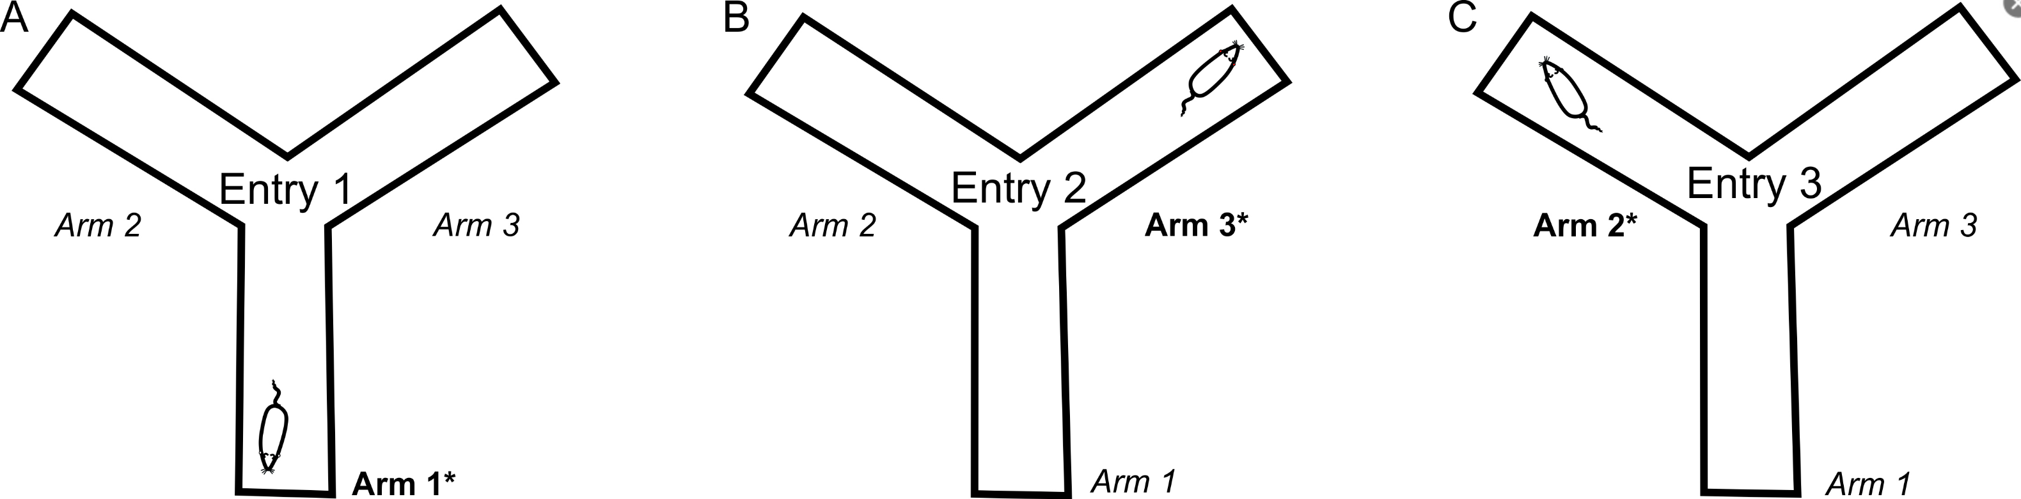
Prieur et al., 2019
BioProtocol

Slide 39
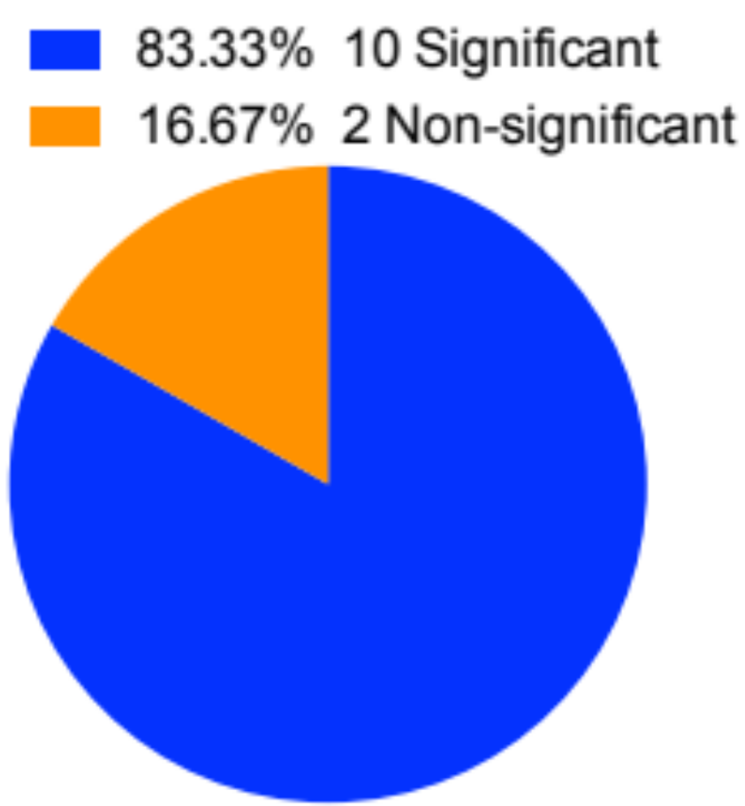
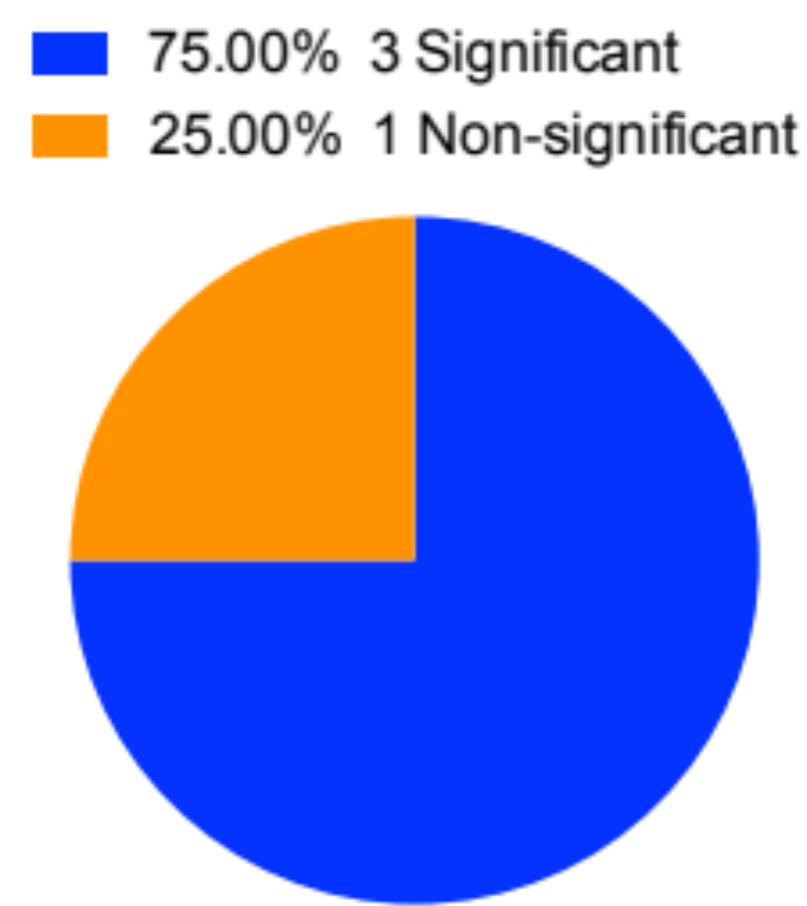
Moderate confidence results in donepezil
Morris water maze
Novel object recognition

Slide 40
Overall results for donepezil
High confidence:
  Y/T maze (9 significant, 1 non-significant)
  Passive avoidance (6 significant, 0 non-significant)
Moderate confidence:
  Morris water maze (10 significant, 2 non-significant)
  Novel object recognition (3 significant, 1 non-significant)
Low confidence:
  Contextual fear conditioning (2 significant)
  Radial arm maze (1 significant)
  Social memory (1 significant)
  Reversal learning (1 significant)
  5-choice serial reaction time (1 significant)

Slide 41
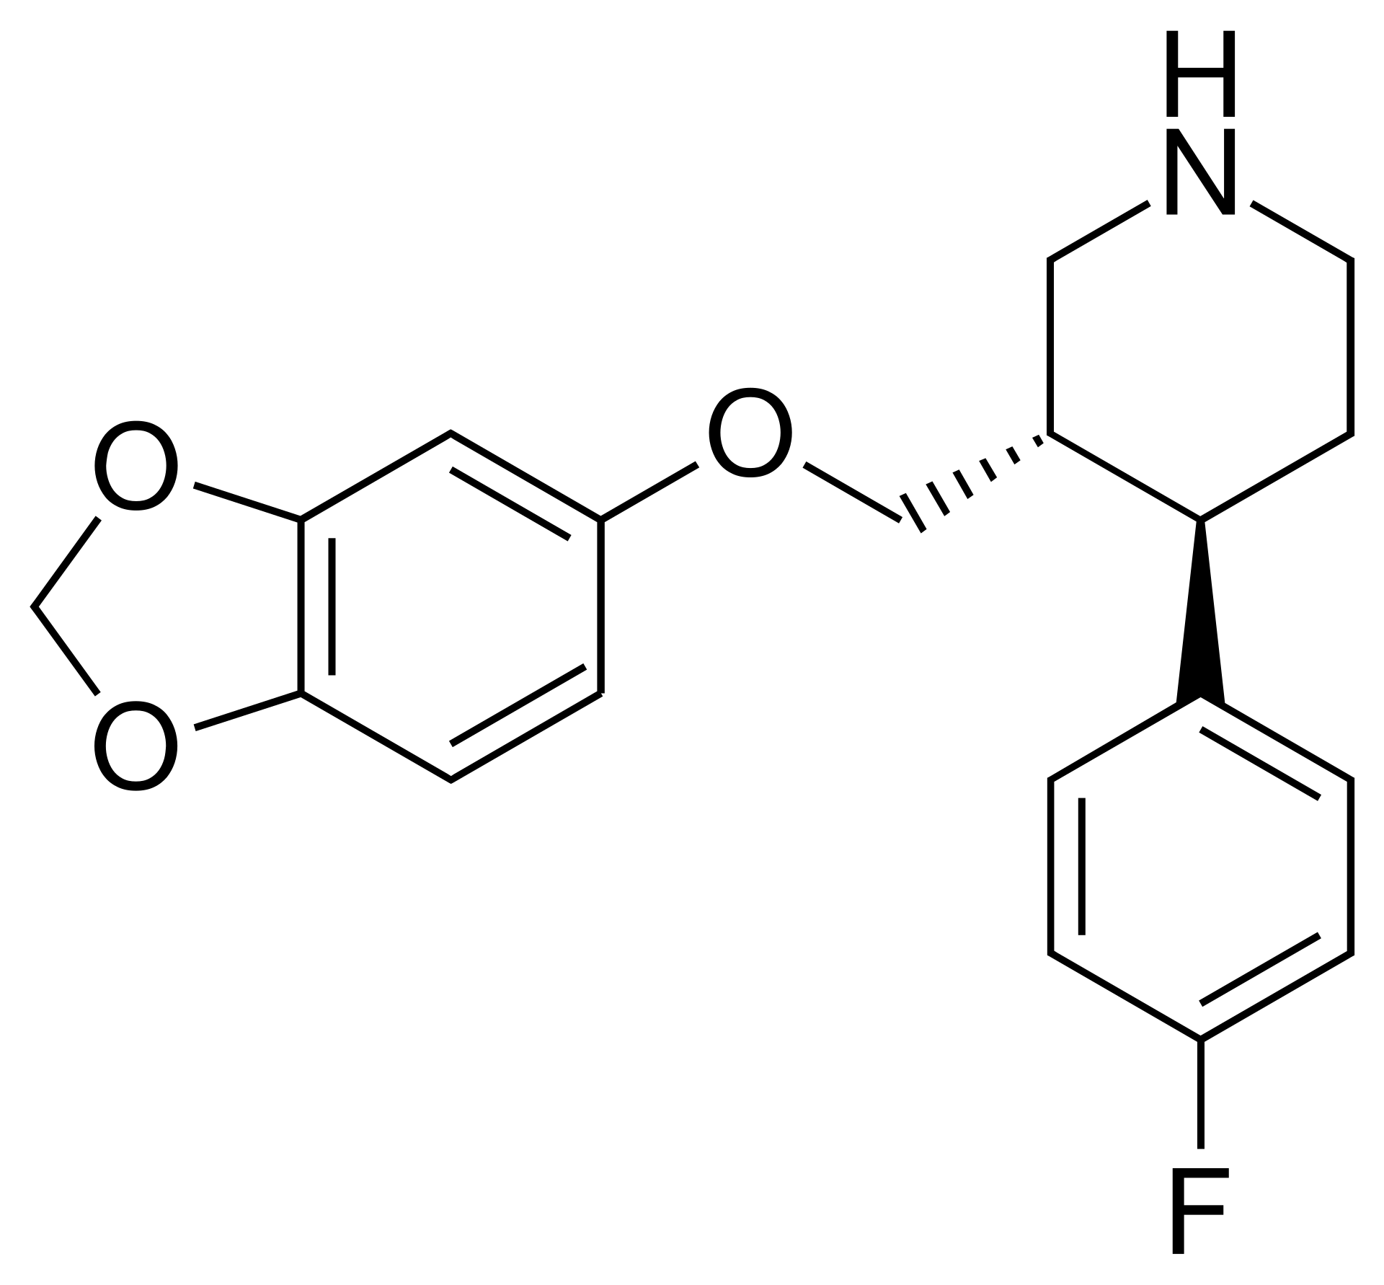
Paroxetine

Slide 42
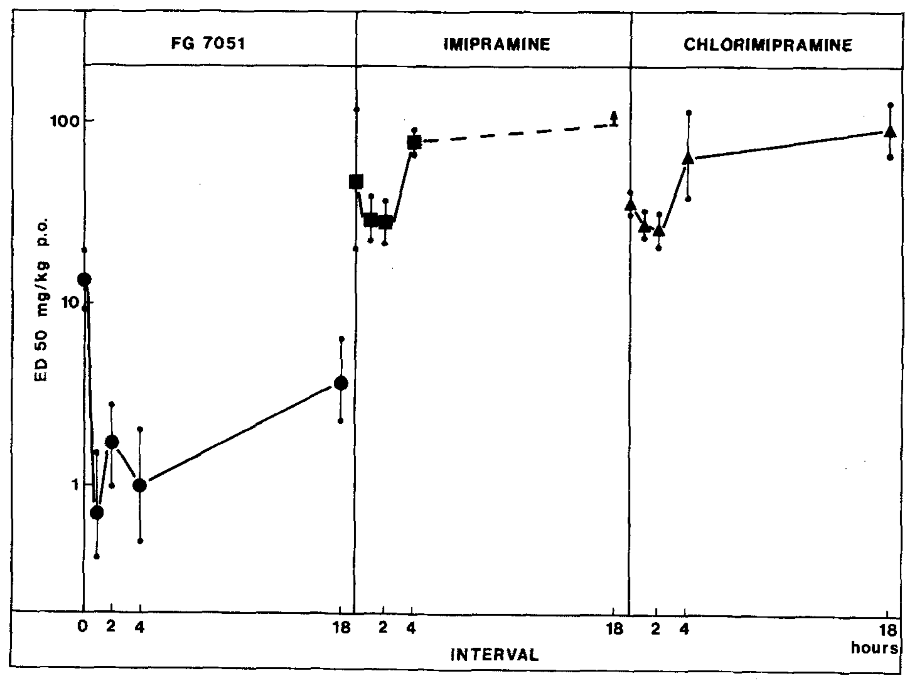
US Patent 4007196

Slide 43
Authors | Journal | Year | Authors | Journal | Year
Aragao et al. | Pharmacology, Biochemistry and Behavior | 2006 | Krass et al. | Neuroscience Letters | 2010
Bourin et al. | Progress in Neuro-Psychopharmacology & Biological Psychiatry | 1998 | Liu et al. | Journal of Psychiatric Research | 2003
Clenet et al. | European Neuropsychopharmacology | 2001 | Mayorga et al. | Journal of Pharmacology and Experimental Therapeutics | 2001
Cryan et al. | PNAS | 2004 | Millan et al. | European Neuropsychopharmacology | 2010
Cunha et al. | Progress in Neuro-Psychopharmacology & Biological Psychiatry | 2008 | O’Neill et al. | Pharmacology, Biochemistry, and Behavior | 1996
Da-Rocha et al. | Journal of Psychopharmacology | 1997 | Ohgi et al. | Pharmacology, Biochemistry, and Behavior | 2013
David et al. | Behavioral Brain Research | 2001 | Perrault et al. | European Journal of Pharmacology | 1992
David et al. | Psychopharmacology | 2003 | Redrobe et al. | Fundamentals of Clinical Pharmacology | 1996
Elizalde et al. | Psychopharmacology | 2008 | Redrobe et al. | Journal of Psychopharmacology | 1998
Gai et al. | Psychopharmacology | 2014 | Renard et al. | Progress in Neuro-Psychopharmacology & Biological Psychiatry | 2001
Gassen et al. | PLOS Medicine | 2014 | Ripoll et al. | Behavioral Brain Research | 2003
Ghasemi et al. | Psychopharmacology | 2009 | Sanchez and Meier | Psychopharmacology | 1997
Guilloux et al. | Neuropharmacology | 2006 | Sillaber et al. | Psychopharmacology | 2008
Guilloux et al. | Neuropsychopharmacology | 2011 | Thoeringer et al. | Journal of Psychopharmacology | 2010
Guzzetti et al. | European Journal of Pharmacology | 2008 | Vaugeois et al. | Psychopharmacology | 1997
Hirano et al. | British Journal of Pharmacology | 2004

Slide 44
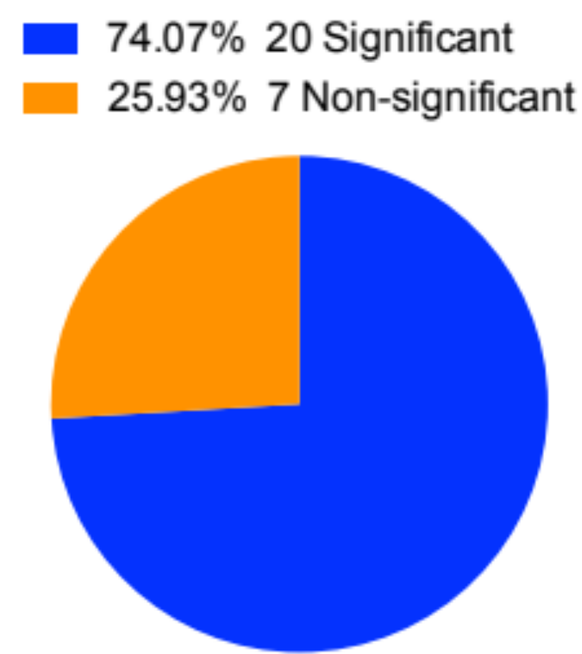
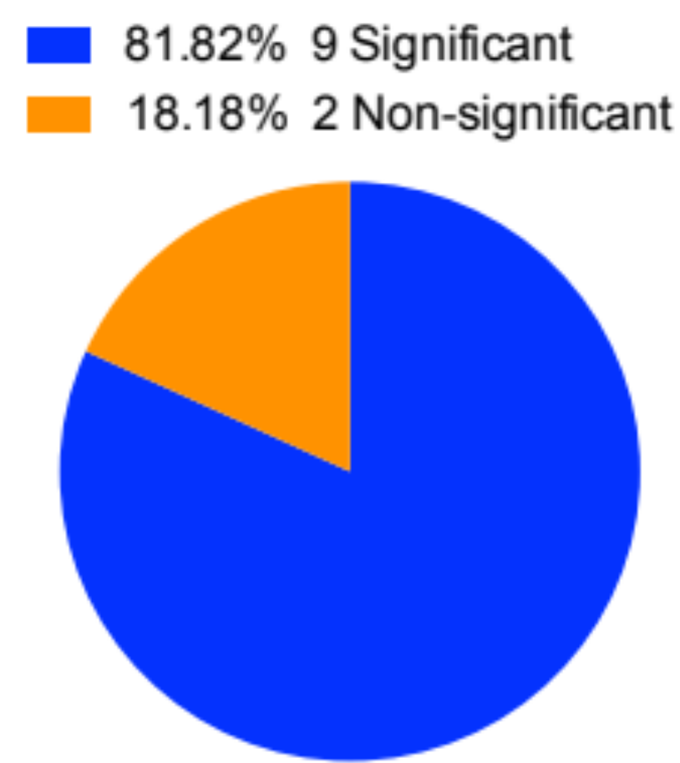
Moderate confidence results in paroxetine
Forced swim test
Tail suspension test

Slide 45
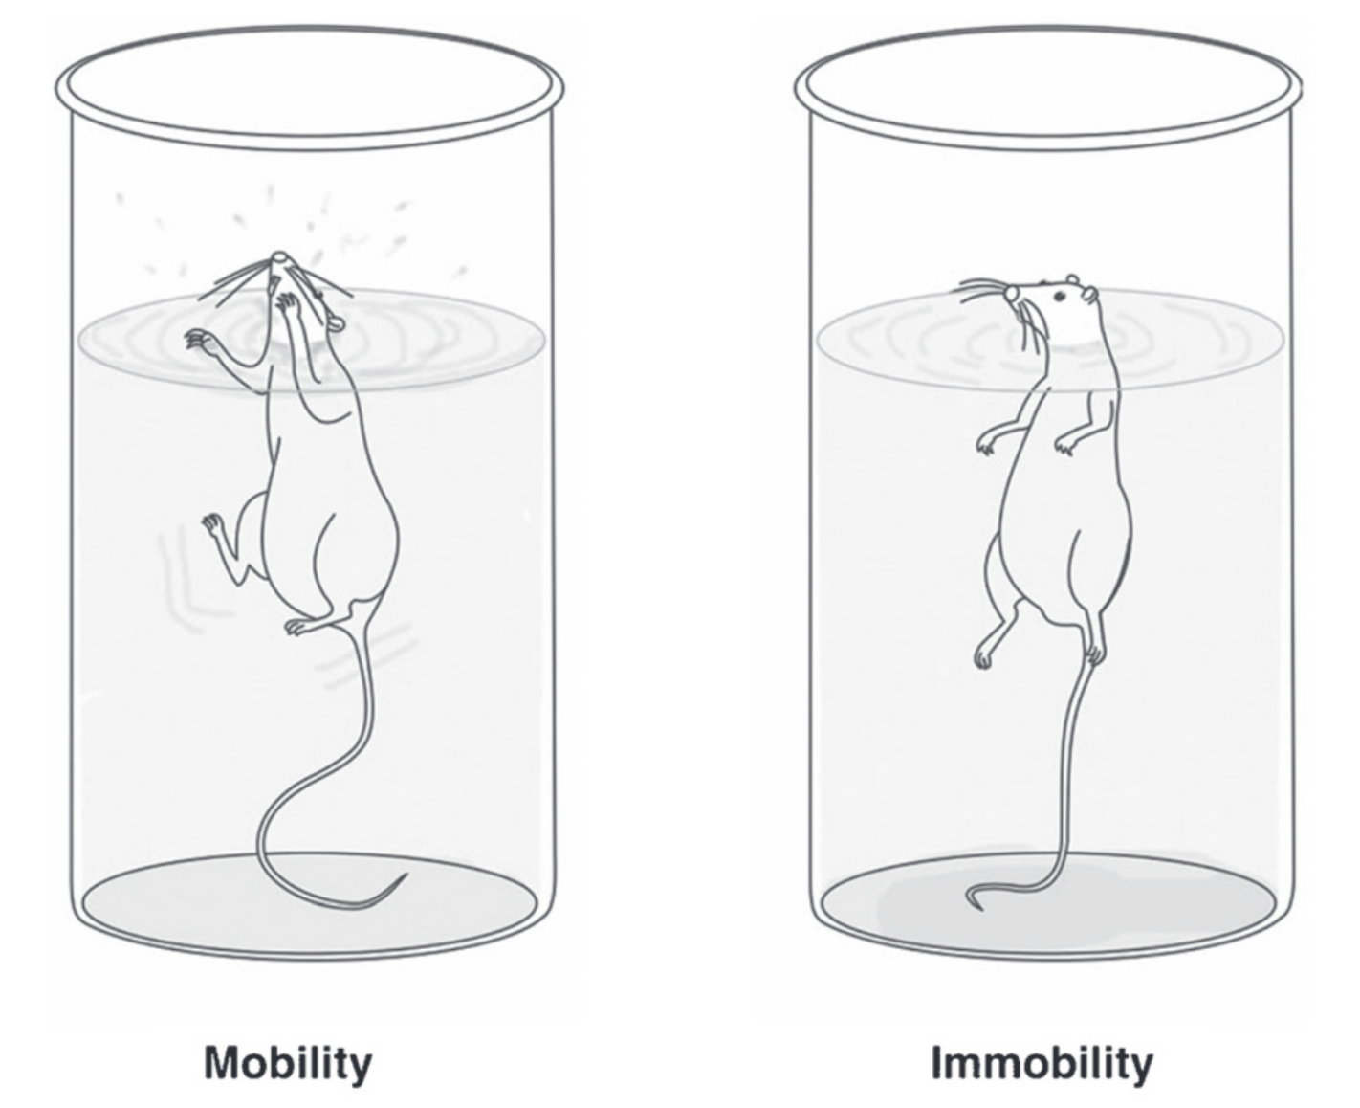
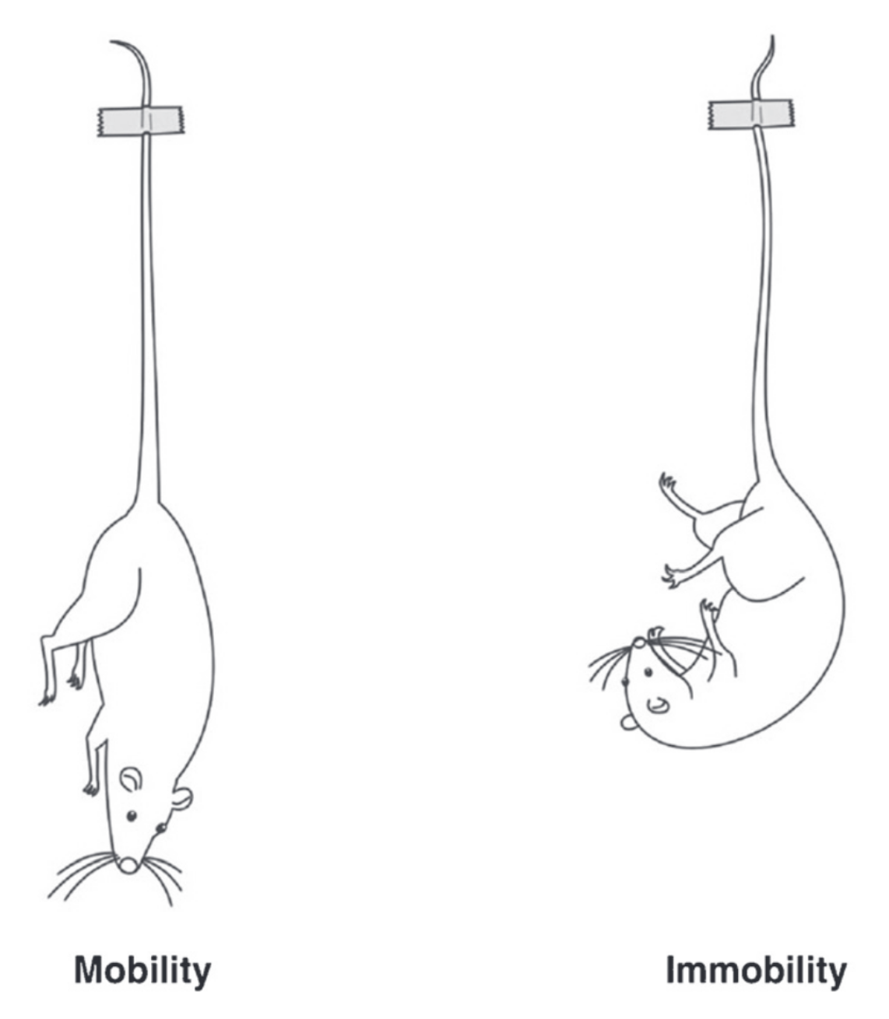
Abelaira et al., 2013
Br J Psychiatry

Slide 46
Overall results for paroxetine
High confidence:
  None
Moderate confidence:
  Forced swim test (20 significant, 7 non-significant)
  Tail suspension test (9 significant, 2 non-significant)
Low confidence:
  None
Ineffective:
  Sucrose preference test (all non-significant)

Slide 47
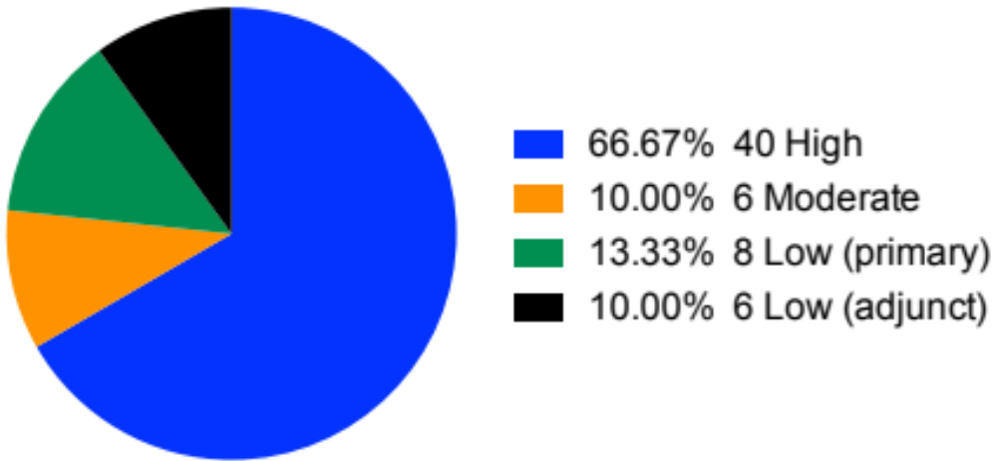
Total overall results

Slide 48
Overall results
Not enough evidence for mice to be responsible
Results track field-specific reviews
  Pain and epilepsy work well
  Antidepressants not so much
Single assays sometimes model entire diseases
No one assay predictive

Slide 49
Where do we go from here?
Pre-register preclinical trials
Increase group sizes
Use multiple non-overlapping behavioral assays
Have overlapping teams for replication
Identify shared predictive biomarkers
Assess and standardize existing behavioral assays
Design and validate new behavioral assays

Slide 50
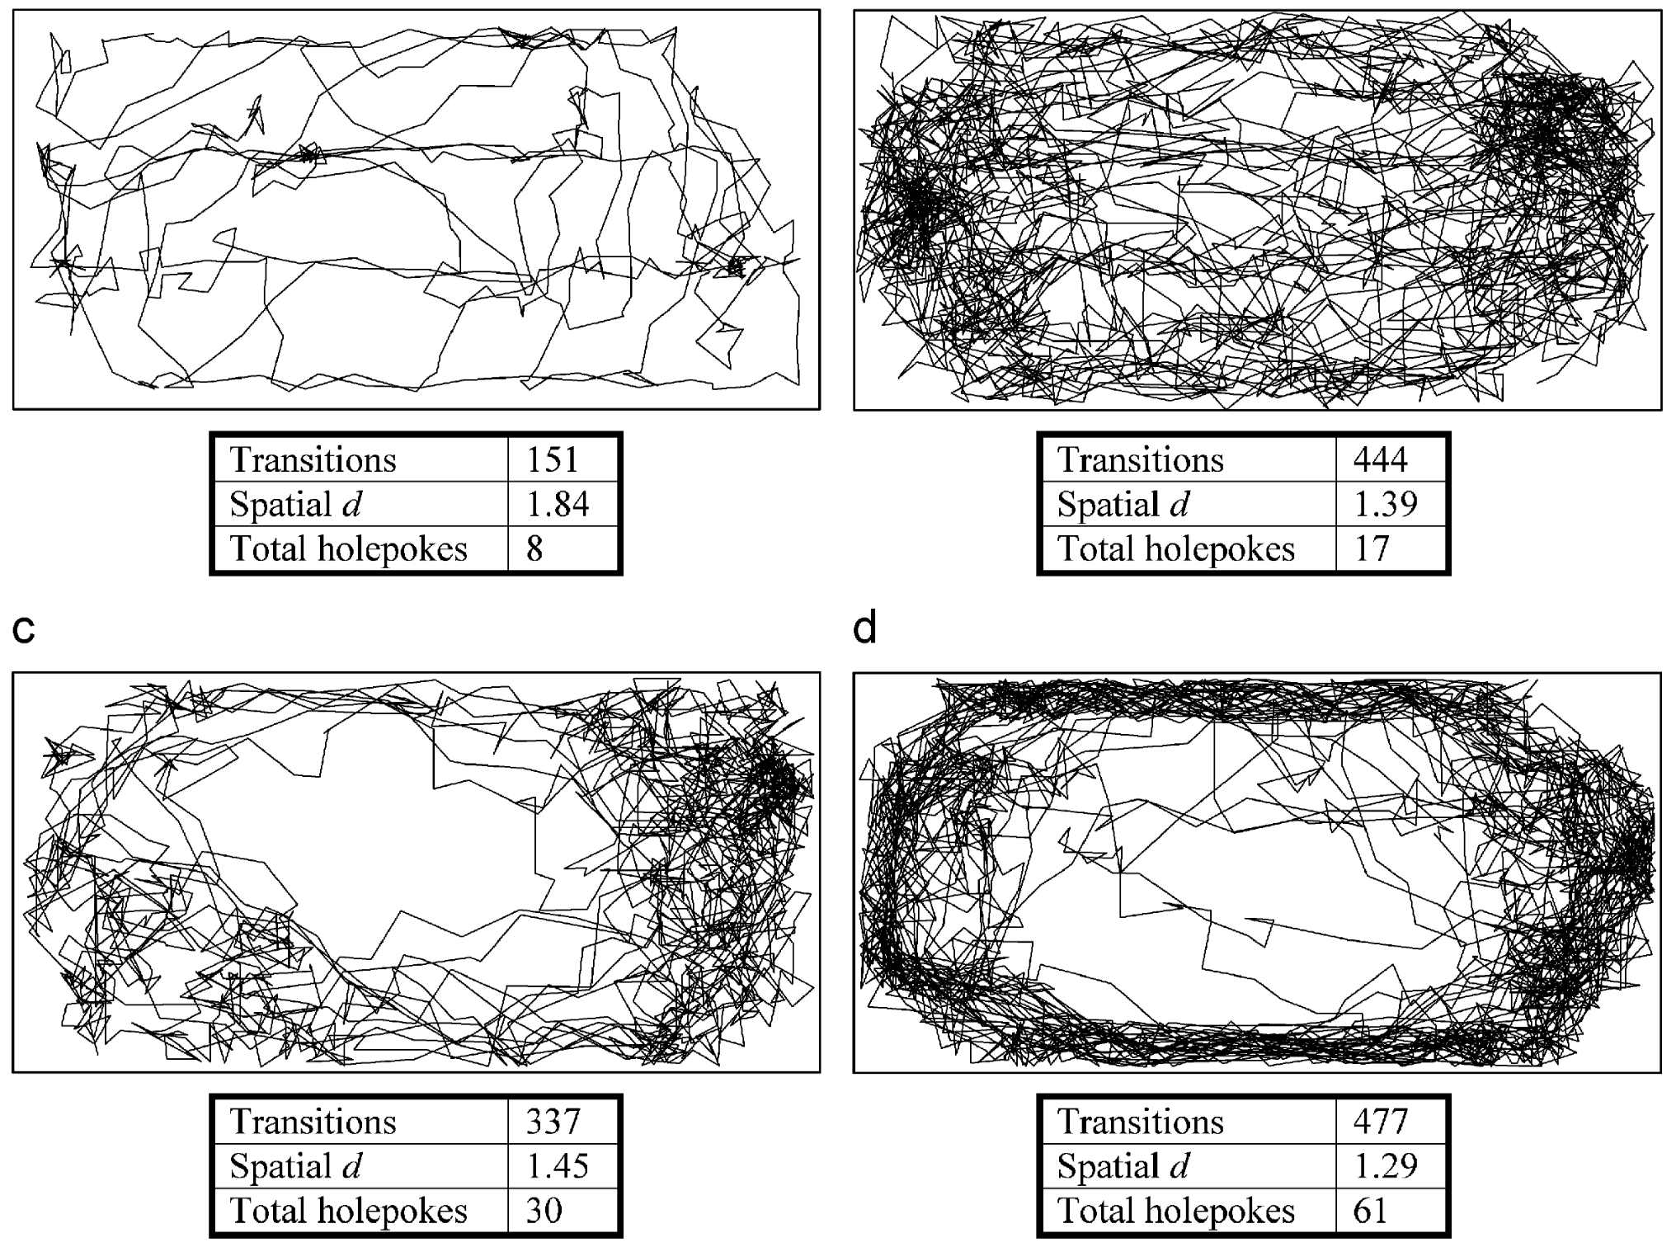
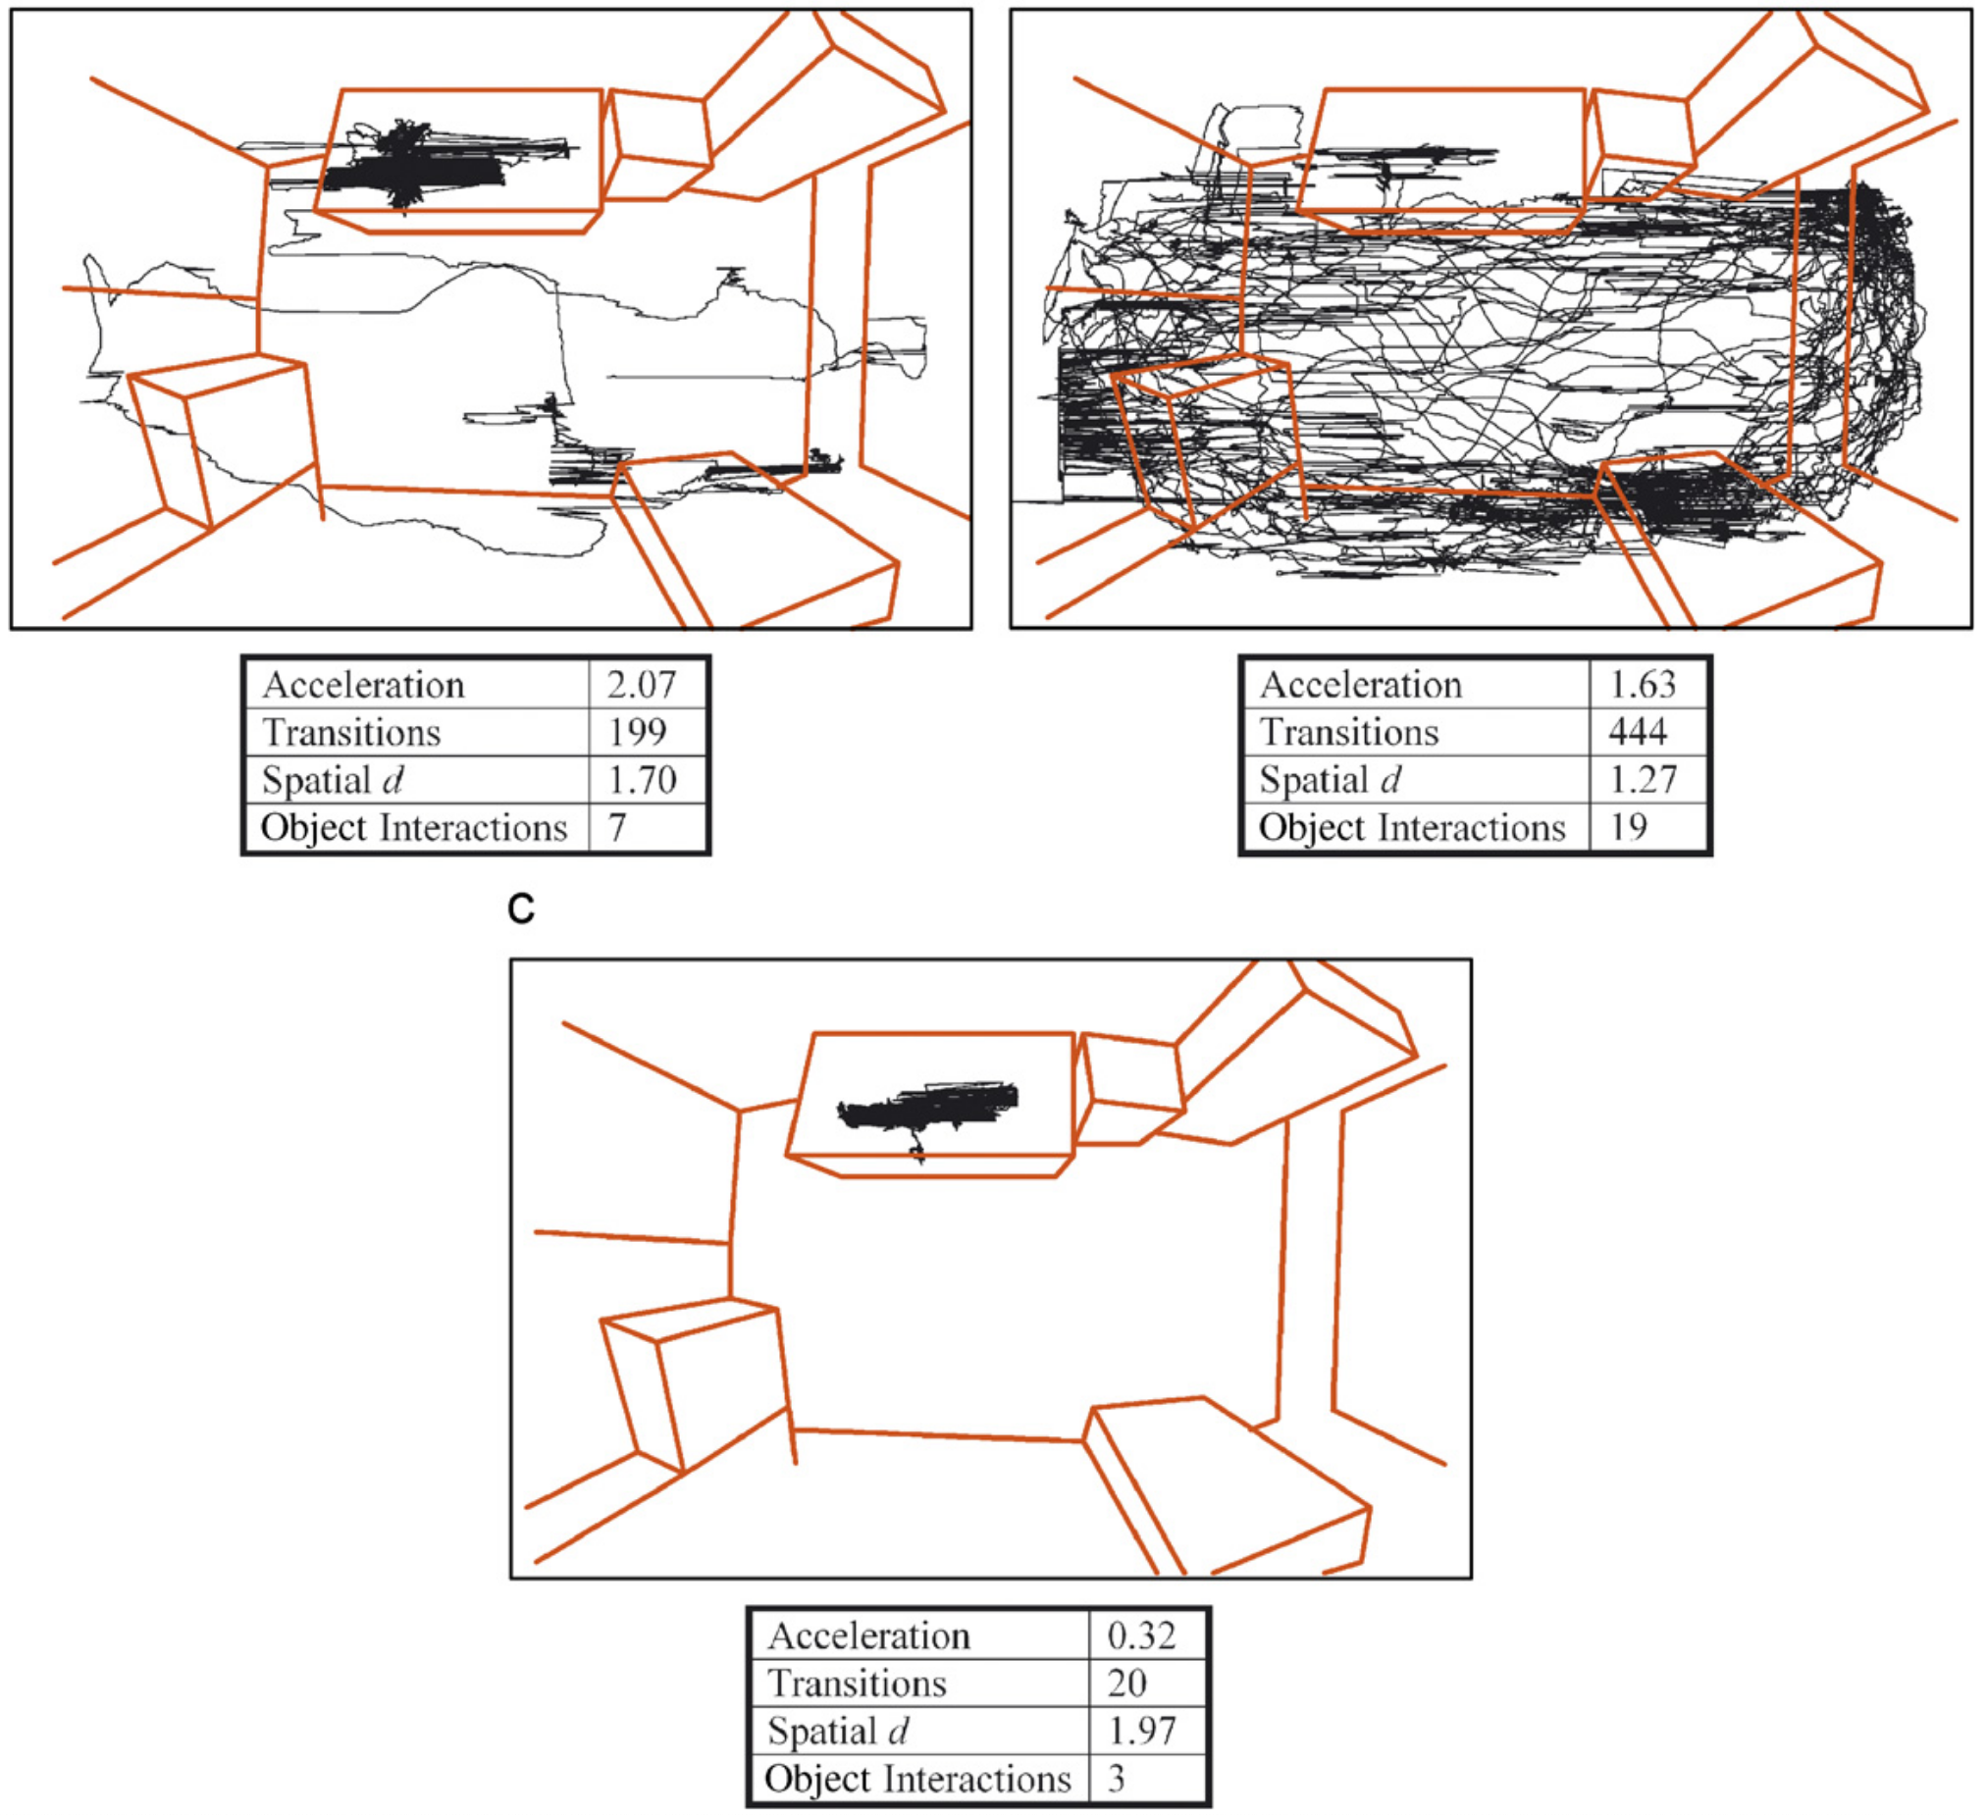
Behavioral Pattern Monitor
Mouse
Human
Young et al., 2007
Neurosci Biobehav Rev

Slide 51
Acknowledgments
Alcino Silva
Peyman Golshani
Stuart Lipton
Mark Bear
Eric Klann
Lennart Mucke
Mustafa Sahin

